Slide 1
Focus on Performance Crawl – Walk – Run
Not just learning, but doing
OCTOBER
NOVEMBER
DECEMBER
JANUARY
FEBRUARY
MARCH
APRIL
MAY
JUNE
JULY
27
10
24
8
12
9
2
23
13
4
25
14-15
6
1. Start – sales basics
2. USPs
3. Objection handling
4. SPIN
5. Negotiation
6. How to pick the right factory
7. Validating RFQs & Factory Prices
8. Quoting & Gross Margin
9. Quote follow-up
10. Complaint handling
11. Strategic business intelligence
12. Workshop
13. Follow-up
Self-study & SMART-goals
Self Study:
NCAB Academy: “Quote follow-up” in “Quoting like a needs analyst”
SMART-goal
Online Clinics
Offline workshop

Slide 2
Guidelines
Prepare to be present:
Don’t multitask
Close your Outlook/e-mail provider and other tabs
Have your phone ready
Get a closed question? => Answer with only yes/no
Help each other grow – give feedback

Slide 3
Today’s agenda
SMART-goal follow-up
Quote follow-ups!
SMART goal until next time
Next module

Slide 4
QUOTING & GROSS MARGIN What did we learn last time?

Slide 5
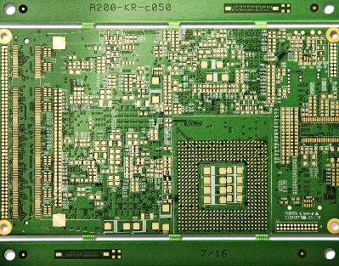
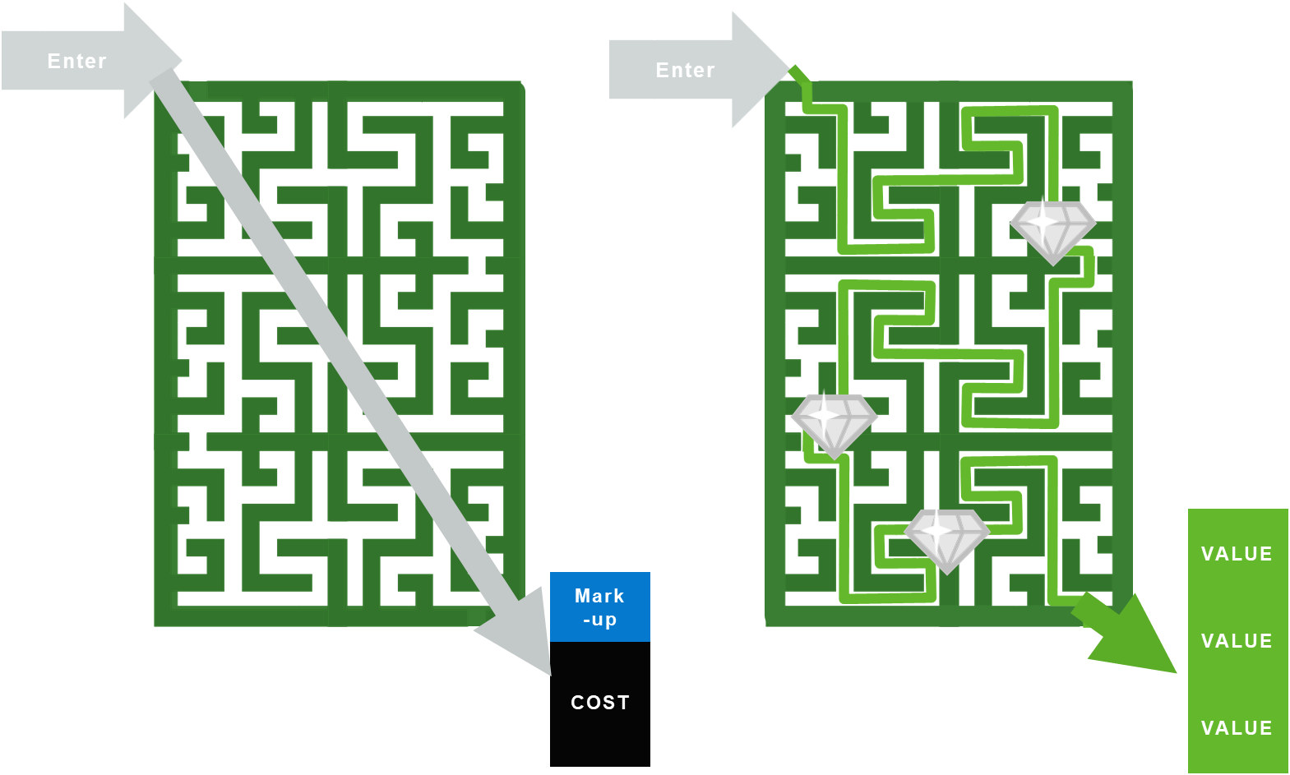
Quote to Win
QUOTE
QUOTE

Slide 6
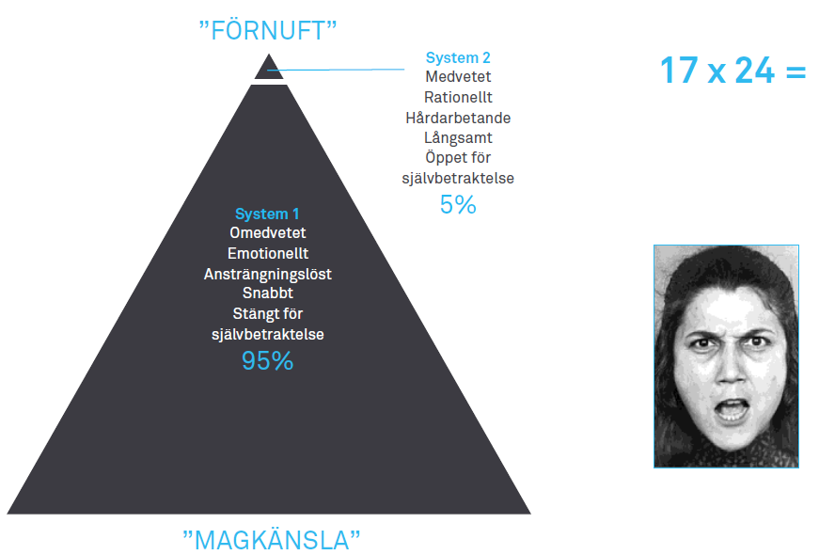
Why do we need the personal touch Kahneman’s Systems 1 and 2
”ANALYTICS”
Consciously
Rational
Hard working
Slow
Unconsciously
Emotional
Effortless
Fast
”GUT FEEL”

Slide 7
+56
-24
0
Be mindful of the profit!
Don’t give anything away without asking for something in return
30%
35,6%
30%
31,8%
Notes:
Lose money and get lower revenue

Slide 8
5% Lower Purcase price: Must raise the Gross Margin % or you loose money
 | Before discount | After discount - Same margin | After discount - Same profit | After discount - Same price
Revenue (price)
COGS (costs)
Gross profit
Gross margin
Outcome for NCAB
1 000
950
965
1 000
-700
-665 (-5%)
-665 (-5%)
-665 (-5%)
300
285
300
335
30,0%
30,0%
31,1%
33,5%
-15
0
35
Notes:
Lose money and get lower revenue

Slide 9
What Price and Gross Margin do we need to maintain Contribution?
Be mindful of the contribution!
Don’t give anything away without asking for something in return
Start: Same GM%: Same GP:
Sales 10.000 8.571 9.225
Purchase cost 5.000 5.000 5.000
Freight cost 2.000 1.000 1.000
Gross Profit 3.000 2.571 3.225
Gross margin 30% 30% 35%
EBITDA/result 1.200 771 1.425
Working capital 1.000 2.500 2.500
Interest 15% -150 -375 -375
Contribution 1.050 396 1.050
+654
+654

Slide 10
Breakout room: Follow-up on SMART-goal
Discuss your SMART-goal progress and/or what you have worked/practiced on regarding Quoting & Gross Margin since last time:
How have you practiced your new skills?
How did it go? What was the outcome?
What have you learned?
You will be 2 persons/room and you have 5 min. (If you haven’t met before, BRIEFLY yourselves

Slide 11
What are the main points from the lesson?
What did you learn?

Slide 12
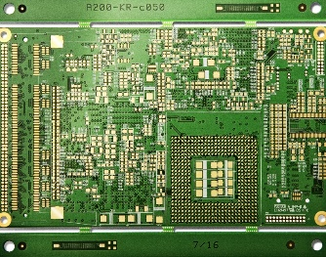
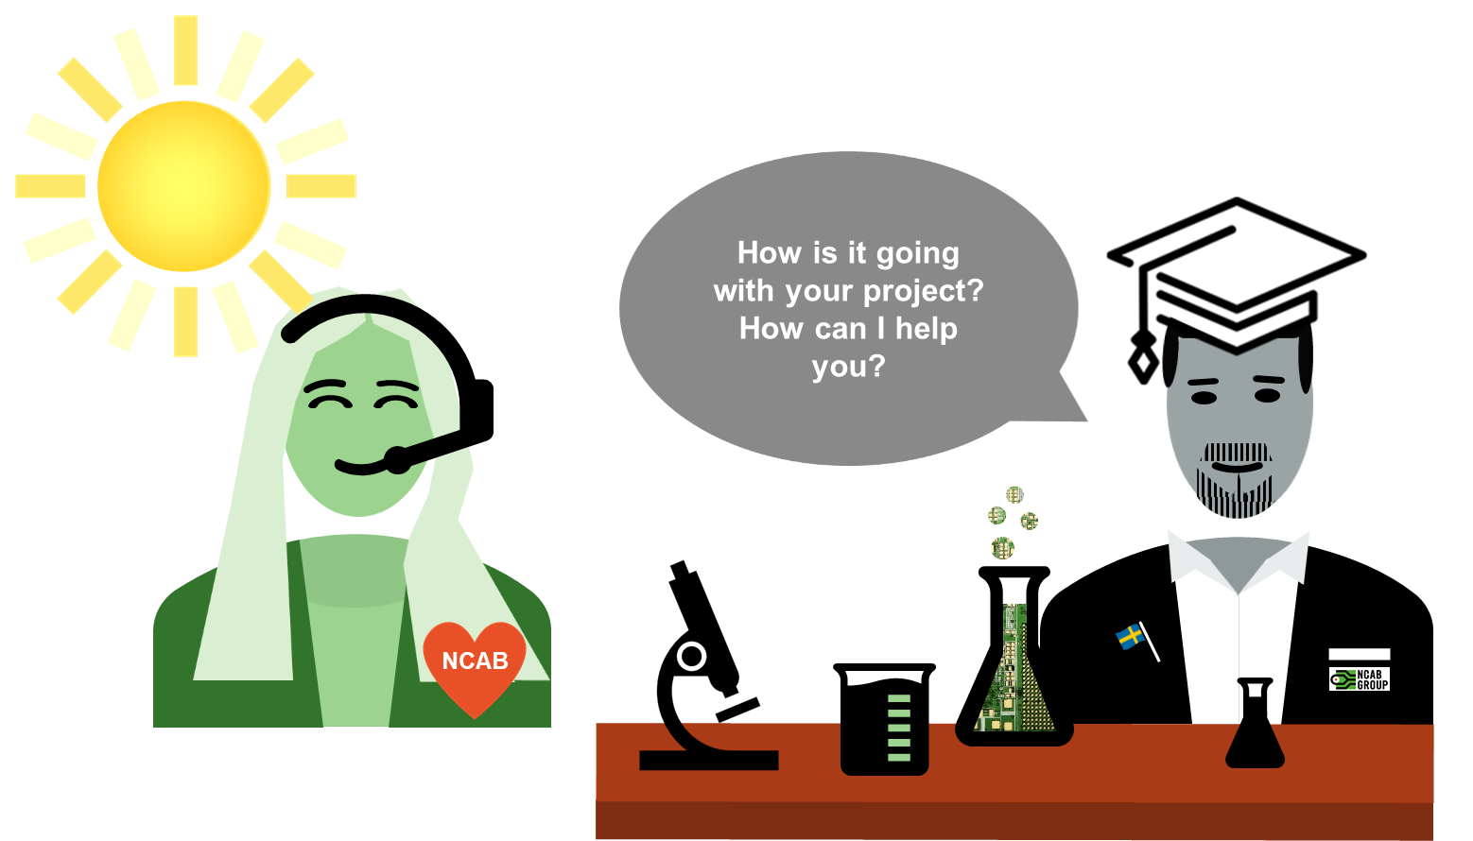

Slide 13
Cheat Sheet
QUOTE FOLLOW-UP CALL
CHECKLIST
Heed the Need
Spotlight on them – help them become more successful
Ask for the order (If… Will…)
ABC - Agree on next step

Slide 14
Quote statistics 2021, IQuote, SuperOffice
20´086 Sold
65´348 Quotes made
42´980 Sold
140´000 Quotes made
Win Rate 30,7%
30,7% Sold
Totally 3600 Customers Quoted
Strong
446
53´000 Quotes
35,5% Sold
Medium
598
34´000Quotes
30,8% Sold
Weak
361
9´200 Quotes
29,1% Sold
Sales Funnel
312
7´600 Quotes
20,7% Sold
Prospects
225
5´000 Quotes
18,6% Sold

Slide 15
Quote statistics 2021, IQuote, SuperOffice
20´086 Sold
65´348 Quotes made
42´980 Sold
140´000 Quotes made
Win Rate 30,7%
30,7% Sold
Totally 3600 Customers Quoted
Strong
446
53´000 Quotes
Its all about
Relationship
35,5% Sold
Medium
598
34´000Quotes
30,8% Sold
Weak
361
9´200 Quotes
29,1% Sold
Sales Funnel
312
7´600 Quotes
20,7% Sold
Prospects
225
5´000 Quotes
18,6% Sold

Slide 16
Share a
Positive experience
from a
follow up

Slide 17
Breakout room
What have you learned from the customer during a quote follow-up?
Share with your colleagues
Break Out Room 5 min. (2 persons)

Slide 18
Bad & Good example
qfu
Listen carefully to the roleplay.
What feedback would you like to give to Michael?

Slide 19
Break!
Please open My Profile in Sympa > ”Learning & Development” > ”Goals & Coaching”
www.symahr.net/ncab

Slide 20
Breakout room – Roleplay 1
QUOTE FOLLOW-UP CALL
CHEAT SHEET
Heed the Need
Spotlight on them – help become more successful
Turn on your imagination & creativity!
Person 1 = Customer Person 2 = NCAB Person 3(+4) = Coach to NCAB
Select 1 of the 4 quotes
Start doing quote follow-ups, focus on helping! Focus on: Heed the need and Spotlight on them. NO solution yet! Max 3 min/roleplay – coach takes time!
The Coach gives feedback to NCAB (1 min)
Rotate
You will be 3-4 persons per room and you have 15 min.

Slide 21
QUOTE 1
8 700$/batch
10 batches/year
28% GM
Suntak HDI
New revision
Technical problem with end customer
Decision next week
QUOTE 2
9 200$/batch
4 batches/year
22% GM
TTEC 4L std
Instructed to buy from competitor by end customer
QUOTE 3
1 200$/batch
6 batches/year
390$ GP/batch
TTEC 2L std
Competitor has bad DP
Price sensitive
QUOTE 4
670$/batch
4 batches/year
270$ GP//batch
Suntak 8L std
New part
Leadtime 7 weeks
Payment term 30 days
Needs 1st batch in 4 weeks
INSTRUCTIONS
Person 1 = Customer Person 2 = NCAB Person 3(+4) = Coach to NCAB
Select 1 of the 4 quotes
Start doing quote follow-ups! Max 3 min/roleplay – Coach, take time!
Focus on Heed the need and Spotlight on them
The Coach gives feedback to NCAB (1 min)
Rotate
QUOTE FOLLOW-UP CALL
CHECKLIST
Heed the Need
Spotlight on them – help become more successful

Slide 22
Breakout room – Roleplay 2
Turn on your imagination & creativity!
Person 1 = Customer Person 2 = NCAB Person 3(+4) = Coach to NCAB
Select 1 of the 4 quotes
Start doing quote follow-ups! Now you can focus on solution & next step! 5 min/roleplay – coach takes time!
The Coach gives feedback to NCAB (1 min)
Rotate
You will be 3-4 persons per room and you have 25 min.
QUOTE FOLLOW-UP CALL
CHEAT SHEET
Heed the Need
Spotlight on them – help become more successful
Ask for the order (If… Will…)
ABC - Agree on next step

Slide 23
QUOTE 1
9 300$/batch
35% GM
16L 1+n+1 HDI
Std lead time
Competitor has bad QP
QUOTE 2
25,000$/batch
4 batches/year
22% GM
TTEC 4L std
Air freight
Price sensitive
QUOTE 3
1500$/batch
10 batches/year
420$ GP/batch
TTEC 2L std
Competitor has bad DP
Forecast available
QUOTE 4
670$/batch
320$ GP//batch
IQEL 6L std
New part
Prototypes
Leadtime 10 days
Needs proto in 8 days
Volume to come
INSTRUCTIONS
Person 1 = Customer Person 2 = NCAB Person 3(+4) = Coach to NCAB
Select 1 of the 4 quotes
Start doing quote follow-ups! Max 5 min/roleplay – Coach, take time!
Use the cheat sheet
The Coach gives feedback to NCAB (1 min)
Rotate
QUOTE FOLLOW-UP CALL
CHEAT SHEET
Heed the Need
Spotlight on them – help become more successful
Ask for the order (If… Will…)
ABC - Agree on next step

Slide 24
Reflection
qfu
Take a minute and think about the last time you did a Quote Follow-Up.
Where was your focus, your “spotlight”?
What do you wish you would have done differently?

Slide 25
What is the main thing you learned today?
Write in the chat!

Slide 26
Next clinic (May 4): ”Complaint handling”
In the Program Page (NCAB Academy):
Complete course Complaint handling in Academy
¨Your feedback about the Clinic
Set & complete your SMART-goal

Slide 27
My SMART-goal until next time – How will you practice IRL? Crawl – Walk – Run
S
M
A
R
T
PECIFIC
Think about your SMART-goal that you will do until next time.
Write it down in in your Sympa-profile > ”Learning Development” > ”Goals & Coaching”-tab.
We will follow up how it went at the next Clinic.
EASURABLE
CCEPTED
ELEVANT
IME-BOUND

