Slide 1
Focus on Performance Crawl – Walk – Run
Not just learning, but doing
OCTOBER
NOVEMBER
DECEMBER
JANUARY
FEBRUARY
MARCH
APRIL
MAY
JUNE
JULY
27
10
24
8
12
9
2
23
13
4
25
14-15
6
1. Start – sales basics
2. USPs
3. Objection handling
4. SPIN
5. Negotiation
6. How to pick the right factory
7. Validating RFQs & Factory Prices
8. Quoting & Gross Margin
9. Quote follow-up
10. Strategic business intelligence
11. Complaint handling
12. Workshop
13. Follow-up
Self Study:
NCAB Academy: "Lesson 3: Quote to Win" in "Quoting like a Needs Analyst"
NCAB Academy: "We are all racecar drivers"
SMART-goal
Self-study & SMART-goals
Online Clinics
Offline workshop

Slide 2
Guidelines
Prepare to be present:
Don’t multitask
Close your Outlook/e-mail provider and other tabs
Have your phone ready
Get a closed question? => Answer with only yes/no
Help each other grow – give feedback

Slide 3
Today’s agenda
SMART-goal follow-up
Quote to Win
Gross Margin & Profits
Working Capital
SMART goal until next time
Next module

Slide 4
VALIDATING RFQS & FACTORY PRICES What did we learn last time?

Slide 5
Validating RFQs & Factory Prices

Slide 6
Breakout room: Follow-up on SMART-goal
Discuss your SMART-goal progress and/or what you have worked/practiced on regarding Validating RFQs & Factory Prices since last time:
How have you practice your new skills?
How did it go? What was the outcome?
What have you learned?
You will be 2 persons/room and you have 5 min. (If you haven’t met before, BRIEFLY yourselves

Slide 7
What are the main points in this course?
What did you learn?

Slide 8
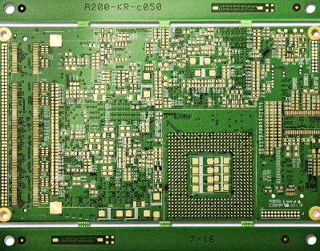
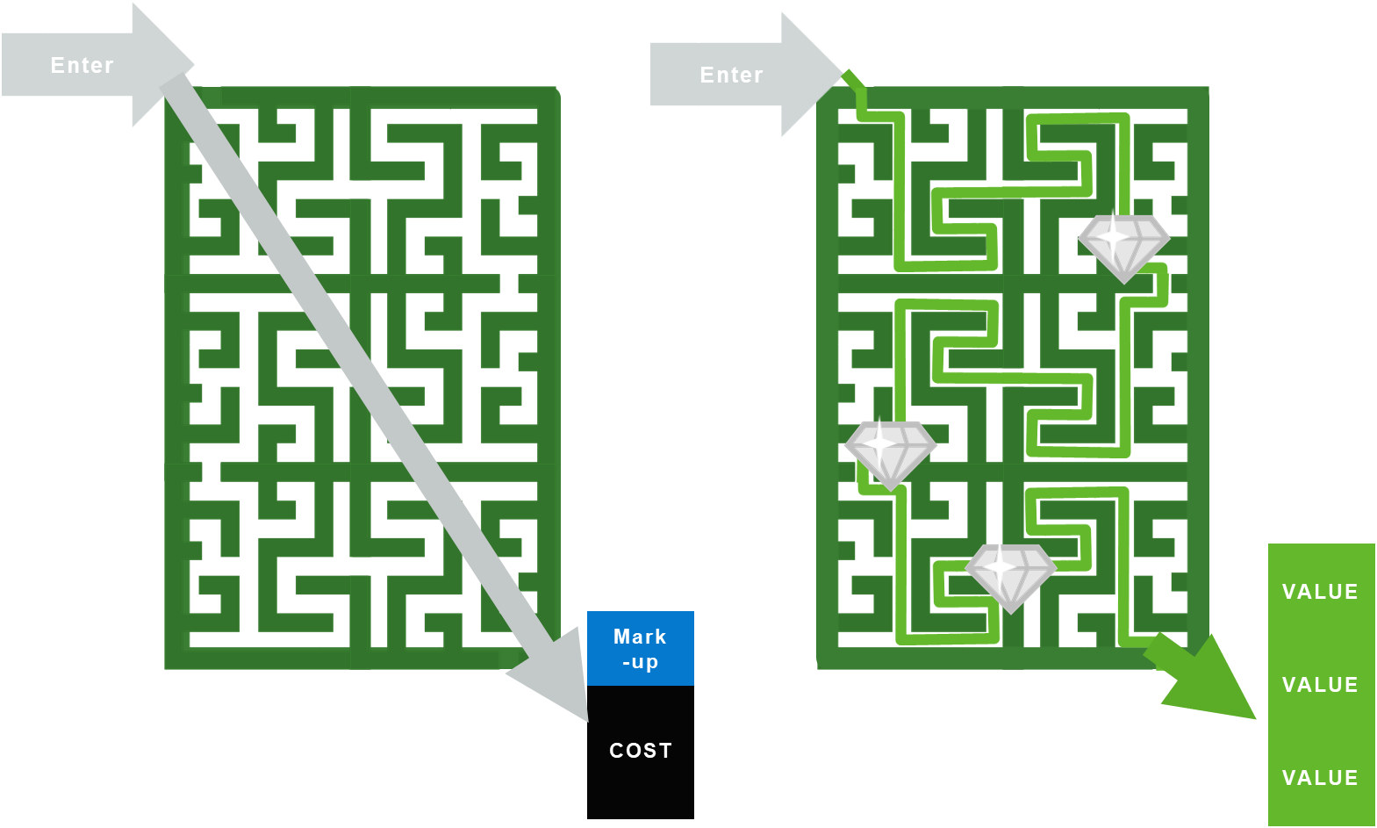
Quote to Win
QUOTE
QUOTE

Slide 9
Why do we want the Personal touch?

Slide 10
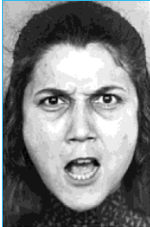

Slide 12
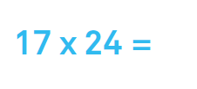

Slide 15
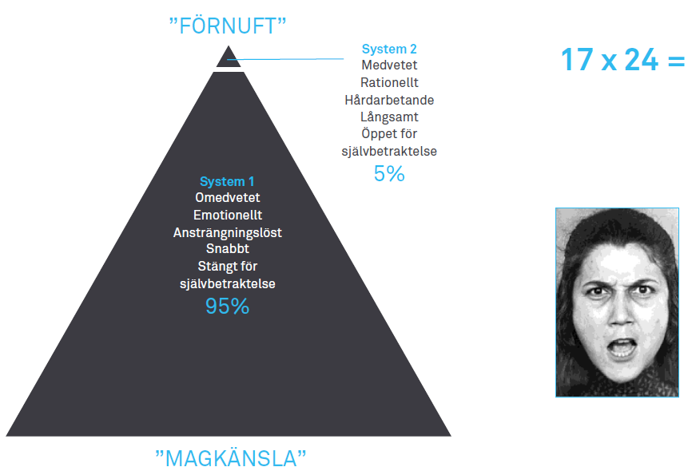
Kahneman’s Systems 1 and 2
”ANALYTICS”
Consciously
Rational
Hard working
Slow
Unconsciously
Emotional
Effortless
Fast
”GUT FEEL”

Slide 17
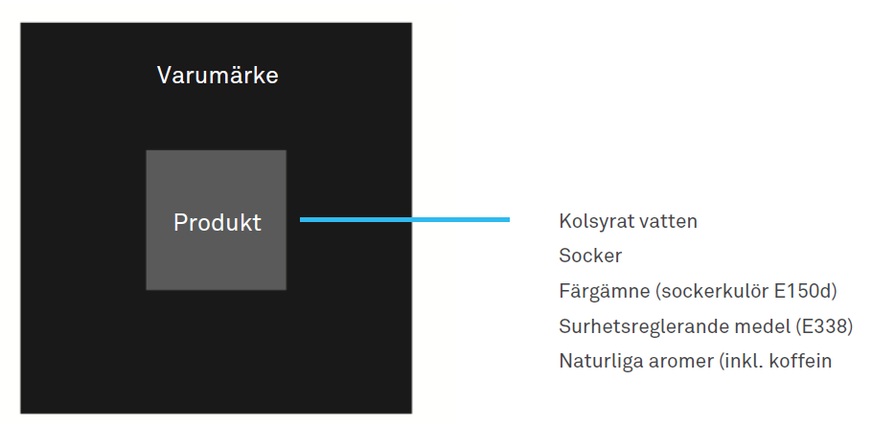
Example
Brand value
Product
Carbonated water
Sugar
Colour additive (E150d)
Acid regulator (E338)
Natural aromas (incl. caffein)

Slide 18
Same rules apply in B2B
Buyers…
… are short on time
… are exposed to risk – personal and financial
… are humans
… are goverened by ”GUT FEEL” in system 1

Slide 19
What about more complex products?
The paradox of choice:
Too many attributes to evaluate results in ”information overload”…
Requires more knowledge
Creates higher alternative costs
Creates uncertainty
Solution by the human brain:
Rules of thumb
Simplifications and
GUT FEEL = System 1

Slide 20
Drivers by Category
Strongest Volume Drivers
Service
Reliability
Customer Focus
Ease of going business with
Expertise and advice
Strongest Price Premium Drivers
Community feeling
Prestige and Status
Value creation
Inspiration
Delivery

Slide 21
Key takeaways
The price a customer is willing to pay is based on the perceived value vs alternatives
Our ability to communicate and differentiate values is key
Cost is only relevant to us (not connected to price)

Slide 22
Breakout room
DTAM = €3M
1st NCAB order = May 2020
Hit-rate = 5%
Quote requirement = 8L HDI, ISO13485 needed
50, 5K (20sqm), 10K (40sqm) pcs
End customer = medical – pre-natal hand held ultrasound devices - ISO13485
Technical discussions
8L HDI - Tight Tolerances
50pcs in 15 days
5000 and 10000 6 weeks LT
You have received & validated this RFQ. Time to write the quote!
But before you do:
What do you usually check yourself before writing the quote, to ensure success?
What do you usually check yourself before you send it to the customer, to ensure success?
Example: systems, colleagues, …
1 person takes notes and shares in big group. You have 7 min to discuss.

Slide 23
What do you usually check yourself before writing the quote? What do you usually check yourself before you send it to the customer?
Checklist before writing:
Checklist before sending:
DTAM = €3M
1st NCAB order = May 2020
Hit-rate = 5%
Quote requirement = 8L HDI, ISO13485 needed
50, 5K (20sqm), 10K (40sqm) pcs
End customer = medical – pre-natal hand held ultrasound devices - ISO13485
Technical discussions
8L HDI - Tight Tolerances
50pcs in 15 days
5000 and 10000 6 weeks LT

Slide 24
What do you usually check yourself before writing the quote? What do you usually check yourself before you send it to the customer?
Checklist:
Quote history
Check End customer relationship
Materials to suggest?
Experience with same quotes with same technology
Prototype at same factory as series?
Lead time at factories for volume & technology?
Look at PSL
Yearly needs/quantity
How high tolerance? DFM!
Discuss with technical department
Check suggestion with factory for better price / product
Check if everything on the list is in the quote
Make note about tolerances / technical info
Note we have reserved capacity at factory (after I have checked of course)
Note we want first-run feedback before 10 000
Check profit & margin – are we making good money?
Invite end customer in the quote
High light added value/complexities in the quote
DTAM = €3M
1st NCAB order = May 2020
Hit-rate = 5%
Quote requirement = 8L HDI, ISO13485 needed
50, 5K (20sqm), 10K (40sqm) pcs
End customer = medical – pre-natal hand held ultrasound devices - ISO13485
Technical discussions
8L HDI - Tight Tolerances
50pcs in 15 days
5000 and 10000 6 weeks LT

Slide 26
Reflection
Based on what you have learned so far:
What will you STOP doing when it comes to quoting in the future?
What will you START doing when it comes to quoting in the future?
What will you CONTINUE doing when it comes to quoting, that you do so well already?

Slide 27
Break!
Please open My Profile in Sympa > ”Learning & Development” > ”Goals & Coaching”
www.symahr.net/ncab

Slide 28
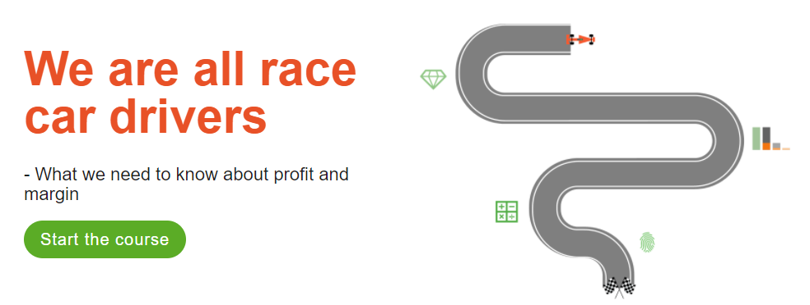
Gross Margin & Gross Profit
Ensure we get paid for the value we provide and Protect our profitability

Slide 29
This is our Expenses on PCB´s as well as freight costs.
This what we pay
This is our Price for PCB´s as well as freight costs, etc
This is what Customer pay
Lets clarify the terms:
Basics:
Cost 1USD
Selling Price: 1,50USD
Adder 50%
Gross profit: 0,50 USD
Gross margin: 33%
This is a % adder on our cost (expenses) to get to a Selling price.
Do not confuse with Gross margin.
Will Show a better way…
This is our first line of Profit.
This is what pays our Rent, Salaries etc
This is the % of Margin our
Gross profit has of our Selling price

Slide 30
Cheat sheet:
Looks fun?
..you will easily do this
in 6 minutes.
Start the timing!

Slide 31
Cheat sheet:
Best calculation ever:
I know my Cost and now want to price it so I hit a wished Gross Margin %
Cost: 248USD I want to get to a Price that gives me 38% Gross Margin.
38% is numerically 0,38
Secret sauce: 0,38...what is missing to get to 1…well 0,62.
Take your Cost and divide it with what's missing to get to one.
248/0,62 = 400USD this is now a selling price with 38% Gross Margin
Now I want 45% Gross margin…well that’s 0,45, now I miss 0,55 to get to 1…so
248/0,55 = 450,90USD, wow Easy!
Lets check…Sell price minus cost = 450,90 -248= 202USD in Gross Profit.
Gross Margin = Gross Profit divided in Selling price = 202/450,9 = 45%

Slide 32
Cheat sheet:
Best calculation ever:
I know my Cost and now want to price it so I hit a Gross Margin %
Cost: 248USD I want to get to a Price that gives me 38% Gross Margin.
38% is numerically 0,38
Secret sauce: 0,38...what is missing to get to 1…well 0,62.
Take your Cost and divide it with what's missing to get to one.
You try it:
You buy PCB´s for 3,40USD + freight 0,68USD = Cost 4,08
Whats your selling price with 37% GM?
4,08/0,63= 6,47USD
Whats your selling price with 32% GM?
4,08/0,68= 6,00USD
6 minutes

Slide 33
Gross Margin example 1
You have an existing business with 30% margin.
Due to NCAB increased leverage with the factory we can reduce our purchase price by 5%
What margin will you quote to the customer using this factory?
 | Before discount | After Discount
Revenue (price) | 1000
COGS (costs) | -700 | -665
Gross profit | 300
Gross margin | 30%

Slide 34
Result example 1
 | Before discount | After discount - Same margin | After discount - Same profit | After discount - Same price
Revenue (price)
COGS (costs)
Gross profit
Gross margin
Outcome for NCAB
1 000
950
965
1 000
-700
-665 (-5%)
-665 (-5%)
-665 (-5%)
300
285
300
335
30,0%
30,0%
31,1%
33,5%
-15
0
35
Notes:
Lose money and get lower revenue

Slide 35
Exercise 2 8% discount.
Break out room 10min
 | Before discount | After discount - Same margin | After discount - Same profit | After discount - Same price
Revenue (price)
COGS (costs)
Gross profit
Gross margin
Outcome for NCAB
1 000
1 000
-700
-644 (-8%)
-644 (-8%)
-644 (-8%)
300
300
30,0%
30,0%
Notes:
Lose money and get lower revenue

Slide 36
Exercise 2 Result 8% discount
 | Before discount | After discount - Same margin | After discount - Same profit | After discount - Same price
Revenue (price)
COGS (costs)
Gross profit
Gross margin
Outcome for NCAB
1 000
920
944
1 000
-700
-644 (-8%)
-644 (-8%)
-644 (-8%)
300
276
300
356
30,0%
30,0%
31,8%
35,6%
-24
0
56
Notes:
Lose money and get lower revenue

Slide 37
Gross Margin walk thru 3 How much more sales do you need to get if you lower price by 5%?
You normally have an existing business with 30% margin for a project / customer.

Slide 38
Exercise 3
 | Base case | After price decrease | Volume for same GP | Volume for same EBITA
Revenue (price)
COGS (costs)
Gross profit
Gross margin
SGA
EBITA
1 000
950
1 140 (+20%)
1 221 (+28,6%)
-700
-700
-840
-900
300
250
300
321
30,0%
26,3%
26,3%
26,3%
150
150
165 (+10%)
171 (+14,3%)
150
100 (-50)
135 (-15)
150 (0)
Notes:
Lose money and get lower revenue

Slide 39
+56
-24
0
Be mindful of the profit!
Don’t give anything away without asking for something in return
30%
35,6%
30%
31,8%
Notes:
Lose money and get lower revenue

Slide 40
Key takeaways – Gross Margin & Gross Profit
Manage Gross Margin and Gross Profit
When costs go down, Gross Margin% needs to increase to keep Gross Profit (pays our salary) and EBITA
We need a Gross Margin also on logistics, as we spend resources on developing logistics solutions just like we do developing a factory portfolio

Slide 41
Working capital
Working capital = The cash we need to do our business
NCAB’s Working capital is approx. 10% of sales Time between getting paid by Customers and us paying our bills and salaries etc. If this time extends…it lock up cash.

Slide 42
Why focus on working capital?
Cash is limited – needed to invest in our company & our future
We sell PCB’s – we are not a bank
Working capital costs interest (% and $)
We need cash for:
Organic growth
Acquisitions

Slide 43
Why focus on working capital?
Like pre paying half year rent – cash is tied up => no Cash to buy food, presents or go to the movies that month…but you got the rent 5% cheaper.

Slide 44
Shifting from Air to Sea transport
Start:
Sales/Price 10.000
Purchase cost 5.000
Freight cost 2.000
Gross Profit 3.000
Gross margin 30%
EBITA/result 1.200
Working capital 1.000
Interest 15% -150
Contribution 1.050

Slide 45
Shifting from Air to Sea transport
Start: Same GM%:
Sales/Price 10.000 8.571
Purchase cost 5.000 5.000
Freight cost 2.000 1.000
Gross Profit 3.000 2.571
Gross margin 30% 30%
EBITA/result 1.200 771
Working capital 1.000 2.500
Interest 15% -150 -375
Contribution 1.050 396

Slide 46
Shifting from Air to Sea transport
Start: Same GM%: Same GP:
Sales/Price 10.000 8.571 9.000
Purchase cost 5.000 5.000 5.000
Freight cost 2.000 1.000 1.000
Gross Profit 3.000 2.571 3.000
Gross margin 30% 30% 33,3%
EBITA/result 1.200 771 1.200
Working capital 1.000 2.500 2.500
Interest 15% -150 -375 -375
Contribution 1.050 396 825

Slide 47
Shifting from Air to Sea transport
exercise
Start: Same GM%:
Sales/Price 10.000 8.571
Purchase cost 5.000 5.000
Freight cost 2.000 1.000
Gross Profit 3.000 2.571
Gross margin 30% 30%
EBITA/result 1.200 771
Working capital 1.000 2.500
Interest 15% -150 -375
Contribution 1.050 396
What Price and Gross Margin do we need to maintain Contribution?

Slide 48
What Price and Gross Margin do we need to maintain Contribution?
result
Start: Same GM%: Same Contribution:
Sales/Price 10.000 8.571
Purchase cost 5.000 5.000 5.000
Freight cost 2.000 1.000 1.000
Gross Profit 3.000 2.571
Gross margin 30% 30%
EBITA/result 1.200 771
Working capital 1.000 2.500
Interest 15% -150 -375
Contribution 1.050 396

Slide 49
What Price and Gross Margin do we need to maintain Contribution?
result
Start: Same GM%: Same Contribution:
Sales/Price 10.000 8.571 10.000
Purchase cost 5.000 5.000 5.000
Freight cost 2.000 1.000 1.000
Gross Profit 3.000 2.571 3.225
Gross margin 30% 30% 32,2%
EBITA/result 1.200 771 1.425
Working capital 1.000 2.500 2.500
Interest 15% -150 -375 -375
Contribution 1.050 396 1.050
+654

Slide 50
What Price and Gross Margin do we need to maintain Contribution?
result
Start: Same GM%: Same GP:
Sales/Price 10.000 8.571 9.225
Purchase cost 5.000 5.000 5.000
Freight cost 2.000 1.000 1.000
Gross Profit 3.000 2.571 3.225
Gross margin 30% 30% 35%
EBITA/result 1.200 771 1.425
Working capital 1.000 2.500 2.500
Interest 15% -150 -375 -375
Contribution 1.050 396 1.050
+654
+654

Slide 51
What Price and Gross Margin do we need to maintain Contribution?
Be mindful of the contribution!
Don’t give anything away without asking for something in return
Start: Same GM%: Same GP:
Sales 10.000 8.571 9.225
Purchase cost 5.000 5.000 5.000
Freight cost 2.000 1.000 1.000
Gross Profit 3.000 2.571 3.225
Gross margin 30% 30% 35%
EBITDA/result 1.200 771 1.425
Working capital 1.000 2.500 2.500
Interest 15% -150 -375 -375
Contribution 1.050 396 1.050
+654
+654

Slide 52
Key takeaways – Working Capital
Lean Working Capital is key to fund further growth
Increased Working Capital => We need to improve Gross Margin%
Can Payment terms be changed to avoid increase in Working Capital?

Slide 53
Key takeaways
The price a customer is willing to pay is based on the perceived value vs alternatives
Our ability to communicate and differentiate values is key
Cost is only relevant to us (not connected to price)
Manage Gross margin and Gross profit
When costs go down, GM% needs to increase to protect GP and EBITA
We need a GM also on logistics as we spend resources on developing logistics solutions just like we do developing a factory portfolio
Lean Working Capital is key to fund further growth
Increased Working Capital => we need to improve GM%
Can Payment terms be changed to avoid increase in WC?

Slide 54
Reflection
We have now practiced on Gross Margin, Gross Profit & Working Capital.
Based on what you have learned so far:
What will you STOP doing when it comes to quoting in the future?
What will you START doing when it comes to quoting in the future?
What will you CONTINUE doing when it comes to quoting, that you do so well already?
Take a few min and set your SMART Goals .

Slide 55
Next clinic (Apr 13): ”Quote follow-up”
In the Program Page (NCAB Academy):
Your feedback about the Clinic (very important!)
Set & complete your SMART-goal
Complete "Lesson 4: Quote follow-up" in "Quoting like a Needs Analyst"

Slide 56
My SMART-goal until next time – How will you practice IRL? Crawl – Walk – Run
S
M
A
R
T
PECIFIC
Think about your SMART-goal that you will do until next time.
Write it down in in your Sympa-profile > ”Learning Development” > ”Goals & Coaching”-tab.
We will follow up how it went at the next Clinic.
EASURABLE
CCEPTED
ELEVANT
IME-BOUND

Slide 57
What is the main thing you learned today?
Write in the chat!

Slide 58
Next clinic (Apr 13): ”Quote follow-up”
In the Program Page (NCAB Academy):
Your feedback about the Clinic (very important!)
Set & complete your SMART-goal
Complete "Lesson 4: Quote follow-up" in "Quoting like a Needs Analyst"

Slide 59
My SMART-goal until next time – How will you practice IRL? Crawl – Walk – Run
S
M
A
R
T
PECIFIC
Think about your SMART-goal that you will do until next time.
Write it down in in your Sympa-profile > ”Learning Development” > ”Goals & Coaching”-tab.
We will follow up how it went at the next Clinic.
EASURABLE
CCEPTED
ELEVANT
IME-BOUND

