Slide 1
Focus on Performance Crawl – Walk – Run
Not just learning, but doing
OCTOBER
NOVEMBER
DECEMBER
JANUARY
FEBRUARY
MARCH
APRIL
MAY
JUNE
JULY
27
10
24
8
12
9
2
23
13
4
25
14-15
6
1. Start – sales basics
2. USPs
3. Objection handling
4. SPIN
5. Negotiation
6. How to pick the right factory
7. Validating RFQs & Factory Prices
8. Quoting & Gross Margin
9. Quote follow-up
10. Strategic business intelligence
11. Complaint handling
12. Workshop
13. Follow-up
Self Study:
Quoting like a Needs Analyst:
"Lesson 1: Introduction“ - "Lesson 2: Validating RFQs"
SMART-goal
Self-study & SMART-goals
Online Clinics
Offline workshop

Slide 2
Guidelines
Prepare to be present:
Don’t multitask
Close your Outlook/e-mail provider and other tabs
Have your phone ready
Get a closed question? => Answer with only yes/no
Help each other grow – give feedback

Slide 3
Today’s agenda
SMART-goal follow-up
Validating RFQs
Factory prices & PCB costs
Reflection
SMART goal until next time
Next module

Slide 4
HOW TO PICK THE RIGHT FACTORY What did we learn last time?

Slide 5
How to pick the right factory summary
What is a good Factory?
How can I identify a good Factory?
What “tools” to use when picking a factory

Slide 6
How to pick the right factory summary
You are responsible for building strong relationships with the factories
If a colleague from another company has better relationship with a factory, meet & share experiences with them! (Contact Cecilia if you need support on who buys where)
Use the metrics when taking decisions!
Put your eggs in different baskets!
You are empowered to take decisions in your daily work life

Slide 7
Breakout room: Follow-up on SMART-goal
Discuss your SMART-goal progress and/or what you have worked/practiced on regarding How to pick the right factory since last time:
How have you practice your new skills?
How did it go? What was the outcome?
What have you learned?
You will be 2 persons/room and you have 5 min. (If you haven’t met before, BRIEFLY yourselves

Slide 8
What are the main points in this course?
What did you learn?

Slide 9
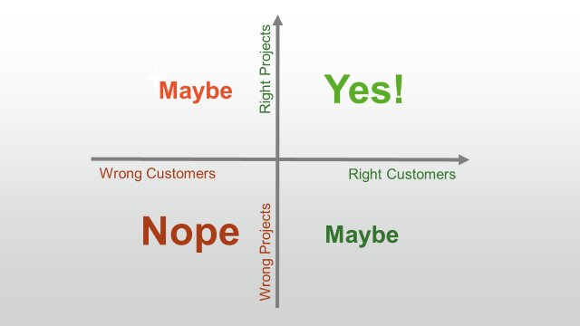
Validating RFQs (Request for Quotes)

Slide 10
Why should we call the customer, investigate & validate the RFQ?

Slide 11
Quote statistics 2021, IQuote, SuperOffice
20´086 Sold
65´348 Quotes made
42´980 Sold
140´000 Quotes made
Win Rate 30,7%
30,7% Sold
Totally 3600 Customers Quoted
Strong
446
53´000 Quotes
35,5% Sold
Medium
598
34´000Quotes
30,8% Sold
Weak
361
9´200 Quotes
29,1% Sold
Sales Funnel
312
7´600 Quotes
20,7% Sold
Prospects
225
5´000 Quotes
18,6% Sold

Slide 12
Quote statistics 2021, IQuote, SuperOffice
Strong | A+ |  | A |  | B |  | C |  | Total
OEM | 1 511 | 34,2% | 1 609 | 41,8% | 1 829 | 55,0% | 167 | 50,3% | 5 116 | 44,6%
EMS | 5 990 | 27,4% | 8 151 | 34,4% | 5 835 | 34,0% | 241 | 51,4% | 20 217 | 32,4%
ODM | 151 | 21,5% | 276 | 32,6% | 526 | 59,8% | 83 | 73,4% | 1 043 | 47,9%
Total | 7 652 | 28,7% | 10 036 | 35,6% | 8 190 | 40,4% | 491 | 54,7% | 26 376 | 35,5%
Medium | A+ |  | A |  | B |  | C |  | Total
OEM | 364 | 32,4% | 1 252 | 38,3% | 1 629 | 45,3% | 136 | 61,7% | 3 381 | 42,0%
EMS | 2 238 | 31,9% | 4 629 | 24,5% | 5 522 | 28,2% | 626 | 17,4% | 13 015 | 27,0%
ODM | 168 | 10,1% | 117 | 30,7% | 682 | 47,0% | 87 | 52,8% | 1 054 | 39,8%
Total | 2 770 | 30,6% | 5 998 | 27,5% | 7 833 | 33,4% | 849 | 28,1% | 17 450 | 30,7%
Weak | A+ |  | A |  | B |  | C |  | Total
OEM | 57 | 43,8% | 206 | 27,2% | 353 | 44,4% | 172 | 57,0% | 788 | 42,6%
EMS | 768 | 17,2% | 1 017 | 22,0% | 1 578 | 29,7% | 237 | 46,4% | 3 600 | 26,0%
ODM | 6 | 33,3% | 21 | 23,8% | 95 | 34,7% | 81 | 29,6% | 203 | 31,5%
Total | 831 | 19,1% | 1 244 | 22,9% | 2 026 | 32,5% | 490 | 47,3% | 4 591 | 29,0%
188
DTAM
9MUSD
727 Customers
DTAM 352 MUSD

Slide 13
Quote statistics 2021, IQuote, SuperOffice
727 Customers
DTAM 352 MUSD
727 Customers, Potential = 352´000´000USD
188 C-Customers Potential = 9´000´000USD
188
DTAM
9 MUSD

Slide 14
Quote statistics YTD 2021Aug, IQuote, SuperOffice
140´000 Quotes made
42´980 Sold
Win Rate 30,7%
7% or 9´800 quotes are
Requotes
75% of Requotes are from EMS
…do we ask the right questions before we quoted first time?
20´000 Quotes to companies are missing:
Category: A+, A, B
Business: OEM, EMS, ODM
Relation: Strong, Weak etc

Slide 15
Why should we call the customer, investigate & validate the RFQ?
140´000 Quotes/year x 30min = 70´000 Hours
We loose 70% = 49´000Hours
6´125 working days…or 26 persons whole work year.
Requotes is over 2,5 man years
Do we need to be smarter and understand what we spend time on.

Slide 16
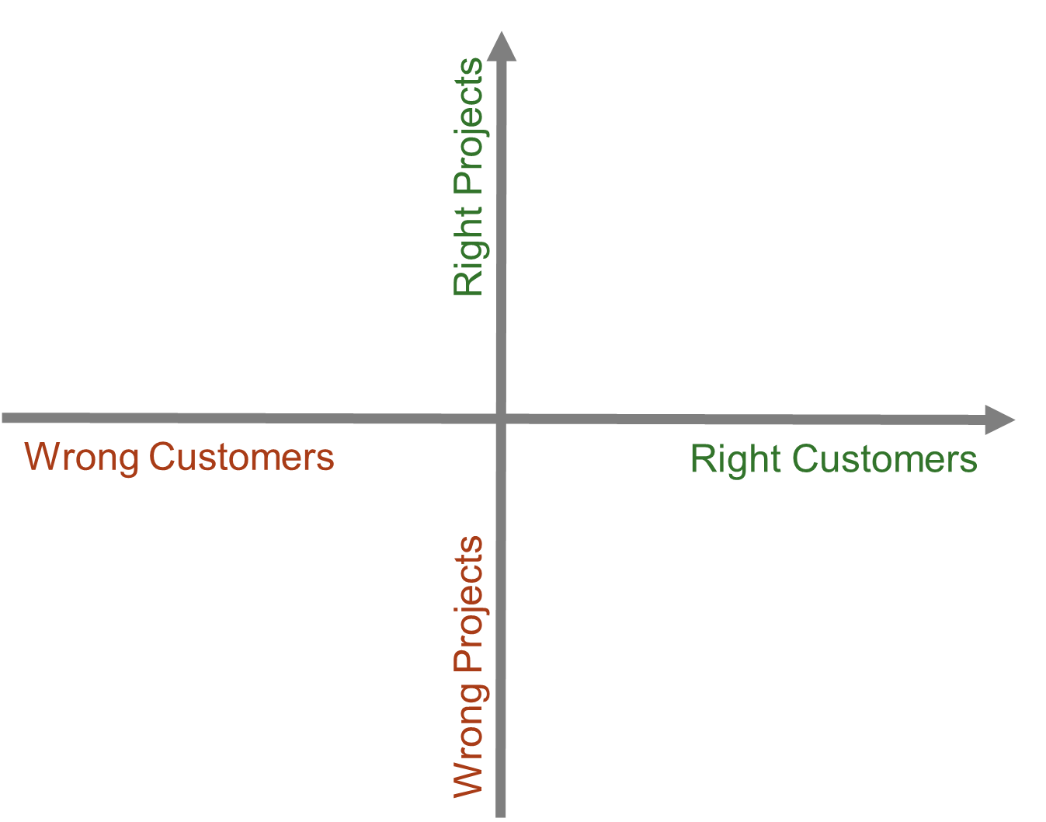
Breakout room – 4 types of RFQs
RFQ A
DTAM = €3M
1st NCAB order = May 2020
Hit-rate = 5%
Quote requirement = 8L HDI, ISO13485 needed.
50, 5K, 10K pcs
RFQ B
DTAM = €3M
1st NCAB order = May 2020
Hit-rate = 5%
Quote requirement = 1L CEM1, 150-200K/batch, 500K EAU
A/B/C/D?
A/B/C/D?
RFQ C
DTAM = €1M
1st NCAB order = May 2021
Hit-rate = 15%
Quote requirement = 8L HDI, AS9100 needed, 150um annular ring, high TG, material.
50, 500, 1000 pcs
RFQ D
DTAM = €3M
1st NCAB order = May 2019
Hit-rate = 35%
Quote requirement = 2L, high frequency/microwave material, galvanic silver finish, 10K/EAU
A/B/C/D?
A/B/C/D?

Slide 17
RFQ A
DTAM = €3M
1st NCAB order = May 2020
Hit-rate = 5%
Quote requirement = 8L HDI, ISO13485 needed.
50, 5K, 10K pcs
A
C
Right Project
RFQ B
DTAM = €3M
1st NCAB order = May 2020
Hit-rate = 5%
Quote requirement = 1L CEM1, 150-200K/batch, 500K EAU
RFQ C
DTAM = €1M
1st NCAB order = May 2021
Hit-rate = 15%
Quote requirement = 8L HDI, AS9100 needed, 150um annular ring, high TG, material.
50, 500, 1000 pcs
Wrong Customer
Right Customer
B
D
RFQ D
DTAM = €3M
1st NCAB order = May 2019
Hit-rate = 35%
Quote requirement = 2L, high frequency/microwave material, galvanic silver finish, 10K/EAU
Wrong Project

Slide 18
Break!
Please open My Profile in Sympa > ”Learning & Development” > ”Goals & Coaching”
www.symahr.net/ncab

Slide 19
Needs analysis questions
You receive the following RFQ and will call the customer to learn more for your needs analysis.
What questions do you usually ask the customer during a needs analysis?
RFQ (Right Customer + Right Project)
DTAM = €1M
1st NCAB order = May 2021
Hit-rate = 15%
Quote requirement = 8L HDI, AS9100 needed, 150um annular ring, high TG, material.
50, 500, 1000 pcs
Leadtime: 10-12 weeks
Share
PS. Write down the questions you like, you will need them!

Slide 20
Role play!
Customer info (Wrong Customer + Right Project):
DTAM €3M
1st NCAB order = May 2020
Hit-rate = 5%
End customer needs ISO13485
8L HDI
50, 5K, 10K pcs
Listen carefully to the roleplay. What feedback would you like to give to Michael?
Good and Bad role play.

Slide 21
Breakout room: Needs analysis of RFQ
instruction
You will soon see a few RFQs from a customer.
Person 1 = Customer Person 2 = NCAB Person 3(+4) = Coach to NCAB
Take a minute to read the RFQ.
Customer: Pick one of the customer situations (don’t tell which). Don’t give everything away at once!!
NCAB: Start your quote needs analysis! Use the cheat-sheet to negotiate. Roleplay for about 5 min.
Coach: Give feedback to NCAB..
Rotate!
You will be 3-4 persons per room and you have 15-20 min.
VALIDATING RFQ-CHECKLIST
Is it a high opportunity customer?
Is it a high opportunity project?
How can we add value?
What are their needs beyond the RFQ? (+ End customer?)
Notes:
- Features are facts about NCAB. - Advantages point out *what the features do. - Benefits describe why this *could be important for this customer.

Slide 22
Breakout room – 3 types of RFQs
RFQ 1
DTAM = €3M
1st NCAB order = May 2020
Hit-rate = 5%
Quote requirement = 8L HDI, ISO13485 needed.
50, 5K, 10K pcs
RFQ 3
DTAM = €3M
1st NCAB order = May 2019
Hit-rate = 35%
Quote requirement = 2L, high frequency/microwave material, 10K/EAU
RFQ 2
DTAM = €1M
1st NCAB order = May 2021
Hit-rate = 15%
Quote requirement = 8L HDI, AS9100 needed, 150um annular ring, high TG, material.
50, 500, 1000 pcs

Slide 23
Factory price & PCB costs

Slide 24
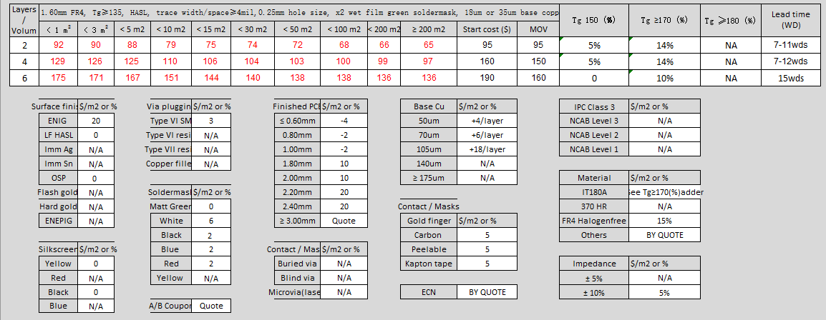
How is the cost of PCB built of?

Slide 25
How is the cost of PCB built of?
Calculate the sqm / batch
SQM = ((pnl size in sqm) ÷ no.of c/p)) x batch qty
SQM = ((0,230m x 0,250m)÷ 4) x 1000
Circuit Size | 105 x 115 mm
Panel Size | 230 x 250 mm
No c/p | 4 up
No of layer | 4L
Material | FR4 Tg150
Finish | ENIG
Ext. Base Copper | 70um
Solder Mask color | Black
Impedance Control | Yes +/- 10%
Batch Quantity | 1000 ccts
Panel Size in meter
No c/p
Batch Quantity
SQM = 0,014375 x 1000 = 14,38 sqm

Slide 26
2. Choose the base price from the matrix based on number of layer and SQM.
Circuit Size | 105 x 115 mm
Panel Size | 230 x 250 mm
No c/p | 4 up
No of layer | 4L
Material | FR4 Tg150
Finish | ENIG
Ext. Base Copper | 70um
Solder Mask color | Black
Impedance Control | Yes +/- 10%
Batch Quantity | 1000 ccts
SQM = 14.38
Base Price = 106 $/sqm

Slide 27
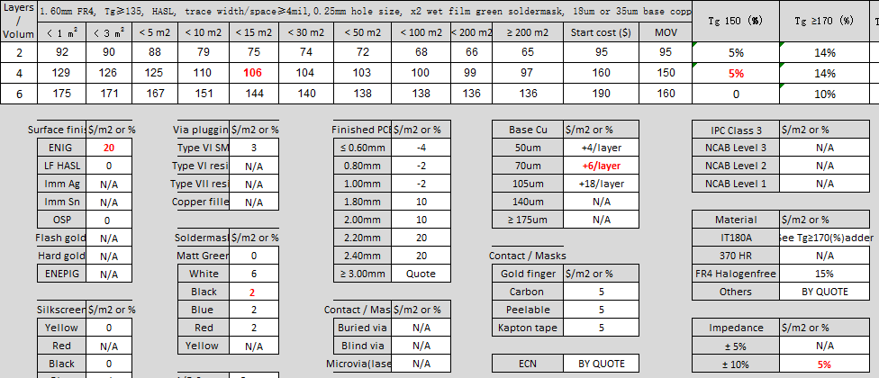
Circuit Size | 105 x 115 mm
Panel Size | 230 x 250 mm
No c/p | 4 up
No of layer | 4L
Material | FR4 Tg150
Finish | ENIG
Ext. Base Copper | 70um
Solder Mask color | Black
Impedance Control | Yes +/- 10%
Batch Quantity | 1000 ccts
3. Calculate the adders.
Base Price = $106
Base Price
= 106 $/sqm
+ Tg 150 = + $5.3
Add Tg150
= +5%
= $106 x 0.05
= $5.3
Add ENIG
= + $20 / sqm
+ Enig = + $20
Add 70um base copper on external layers
= 2 x $6 / sqm
= + $12 / sqm
Add Black Solder Mask
= + $2 / sqm
+ 70um = + $12
Add Impedance Control +/- 10% = +5% of the base price
= $106 x 0.05
= $5.3 / sqm
+ Black SM = + $2
+ Imp. Cont. = + $5.3
Total $/sqm = $150,6

Slide 28
4. Calculate the circuit price
Purchase price = unit size in SQM x price $/sqm
Circuit Size | 105 x 115 mm
Panel Size | 230 x 250 mm
No c/p | 4 up
No of layer | 4L
Material | FR4 Tg150
Finish | ENIG
Ext. Base Copper | 70um
Solder Mask color | Black
Impedance Control | Yes +/- 10%
Batch Quantity | 1000 ccts
Purchase Price = ((0,230m x 0,250m)÷ 4) x 150,6
Purchase Price = 0,014375 x 150,6
Purchase Price = $2,165

Slide 29
Breakout room: Factory quote
instruction
You will soon see a quote from a factory (based on an RFQ from a customer).
Calculate the purchase price from the matrix.
Is the price fair or not?
Why/why not?
What would you do in this situation?
**Factory spreadsheet + tech spec => quote**
You will be 3-4 persons per room and you have 5-10 min.
Notes:
- Features are facts about NCAB. - Advantages point out *what the features do. - Benefits describe why this *could be important for this customer.

Slide 30
Breakout room: Factory quote
instruction
Circuit Size | 85 x 120 mm
Panel Size | 260 x 275 mm
No c/p | 6 up
No of layer | 4L
Material | FR4 Tg150
Finish | ENIG
Ext. Base Copper | 70um
Solder Mask color | Blue
Impedance Control | Yes +/- 10%
Batch Quantity | 2500 ccts
The factory gave us a price of $1.86 per circuit
Calculate the purchase price from the matrix
Is the price fair or not?
Why/why not?
What would you do in this situation?
You will be 3-4 persons per room and you have 5-10 min.
Notes:
- Features are facts about NCAB. - Advantages point out *what the features do. - Benefits describe why this *could be important for this customer.

Slide 31
Breakout room: Practice purchase price calculation
instruction
Notes:
- Features are facts about NCAB. - Advantages point out *what the features do. - Benefits describe why this *could be important for this customer.

Slide 32
How is the cost of PCB built of?
Calculate the sqm / batch
SQM = ((pnl size in sqm) ÷ no.of c/p)) x batch qty
SQM = ((0,260m x 0,275m)÷ 6) x 2500
Circuit Size | 85 x 120 mm
Panel Size | 260 x 275 mm
No c/p | 6 up
No of layer | 4L
Material | FR4 Tg150
Finish | ENIG
Ext. Base Copper | 70um
Solder Mask color | Blue
Impedance Control | Yes +/- 10%
Batch Quantity | 2500 ccts
Panel Size in meter
No c/p
Batch Quantity
SQM = 0,0119166 x 2500 = 29,79 sqm

Slide 33
2. Choose the base price from the matrix based on no. of layer and SQM.
Circuit Size | 85 x 120 mm
Panel Size | 260 x 275 mm
No c/p | 6 up
No of layer | 4L
Material | FR4 Tg150
Finish | ENIG
Ext. Base Copper | 70um
Solder Mask color | Blue
Impedance Control | Yes +/- 10%
Batch Quantity | 2500 ccts
SQM = 29.79
Base Price = 104 $/sqm

Slide 34
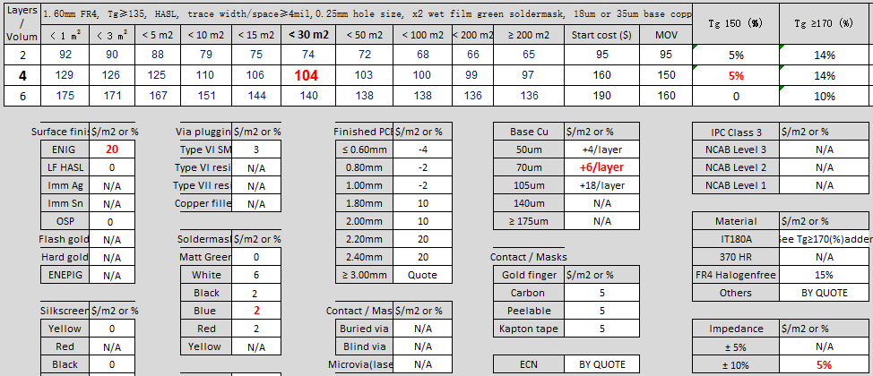
Circuit Size | 85 x 120 mm
Panel Size | 260 x 275 mm
No c/p | 6 up
No of layer | 4L
Material | FR4 Tg150
Finish | ENIG
Ext. Base Copper | 70um
Solder Mask color | Blue
Impedance Control | Yes +/- 10%
Batch Quantity | 2500 ccts
3. Calculate the adders.
Base Price = $104
Base Price
= 104 $/sqm
+ Tg 150 = + $5.2
Add Tg150
= +5%
= $106 x 0.05
= $5.2
Add ENIG
= + $20 / sqm
+ Enig = + $20
Add 70um base copper on external layers
= 2 x $6 / sqm
= + $12 / sqm
Add Blue Solder Mask
= + $2 / sqm
+ 70um = + $12
Add Impedance Control +/- 10% = +5% of the base price
= $104 x 0.05
= $5.2 / sqm
+ Blue SM = + $2
+ Imp. Cont. = + $5.2
Total $/sqm = $148,4

Slide 35
4. Calculate the circuit price
Purchase price = unit size in SQM x price $/sqm
Circuit Size | 85 x 120 mm
Panel Size | 260 x 275 mm
No c/p | 6 up
No of layer | 4L
Material | FR4 Tg150
Finish | ENIG
Ext. Base Copper | 70um
Solder Mask color | Blue
Impedance Control | Yes +/- 10%
Batch Quantity | 2500 ccts
Purchase Price = ((0,260m x 0,275m)÷ 6) x 148,4
Purchase Price = 0,0119166 x 148,4
Purchase Price = $1,768

Slide 36
Matrix purchase price
$1.768
Factory purchase price
$1.86
VS
What would you do in this situation?

Slide 37
What is the main thing you learned today?
Write in the chat!

Slide 38
My SMART-goal until next time – How will you practice IRL? Crawl – Walk – Run
S
M
A
R
T
PECIFIC
Think about your SMART-goal that you will do until next time.
Write it down in in your Sympa-profile > ”Learning Development” > ”Goals & Coaching”-tab.
We will follow up how it went at the next Clinic.
EASURABLE
CCEPTED
ELEVANT
IME-BOUND

Slide 39
Next clinic (23/3): ”Quoting & Gross Margin”
In the Program Page (NCAB Academy):
Your feedback about the Clinic (very important!)
Set & complete your SMART-goal
Complete "Lesson 3: Quote to Win" in "Quoting like a Needs Analyst"
Complete "We are all racecar drivers"

