Slide 1
Focus on Performance Crawl – Walk – Run
Not just learning, but doing
OCTOBER
NOVEMBER
DECEMBER
JANUARY
FEBRUARY
MARCH
APRIL
MAY
JUNE
JULY
27
10
24
8
12
9
2
23
13
4
25
14-15
6
1. Start – sales basics
2. USPs
3. Objection handling
4. SPIN
5. Negotiation
6. How to pick the right factory
7. Validating RFQs
8. Quoting & Gross Margin
9. Quote follow-up
10. Strategic business intelligence
11. Complaint handling
12. Workshop
13. Follow-up
Self-study & SMART-goals
Self Study:
SMART-goal
Online Clinics
Offline workshop

Slide 2
Guidelines
Prepare to be present:
Don’t multitask
Close your Outlook/e-mail provider and other tabs
Have your phone ready
Get a closed question? => Answer with only yes/no
Help each other grow – give feedback

Slide 3
Agenda
What is a good Factory?
How can I identify a good Factory?
What “tools” to use when picking a factory
Discuss and exchange experiences
Practice

Slide 4
Goal / purpose of clinic / performance target
Use data, not gut feel/tradition, when selecting factories & understand the impact of factory choice, and how the best factory affects our success.
Goal behaviour
Selects factory based on price/other term > Selects factory that fits the project/customer (quality, delivery)
Uses 1-2 factories > Uses the whole PSL
Feelings > Statistics, facts
Passive/quote machine > Empowered to take decisions
Doesn’t use PSL > Confidence in using the PSL to advantage

Slide 5
NEGOTIATION What did we learn last time?

Slide 6
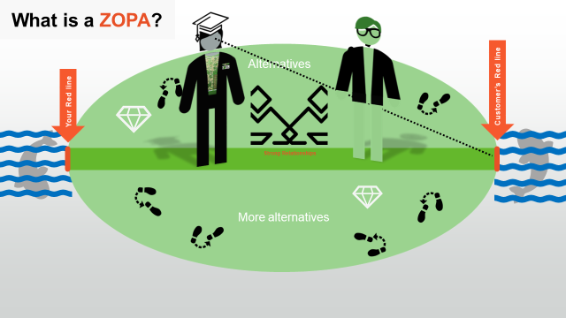
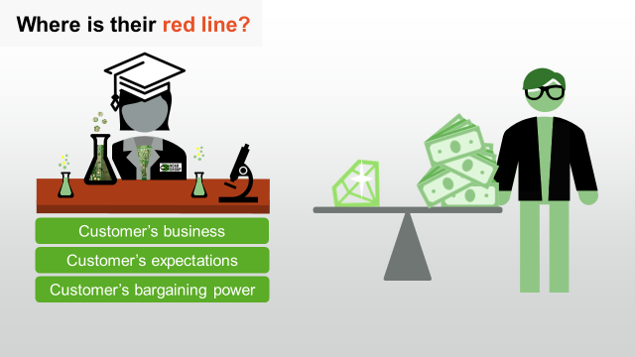
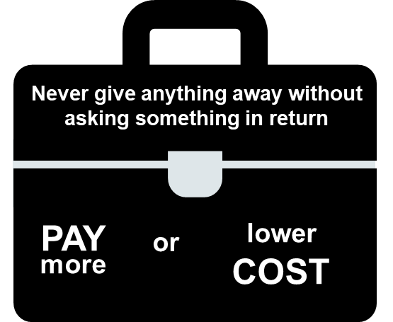
NEGOTIATION CHEAT SHEET
Build strong relationships & Heed the Need – Cooperate to find solution
Show the value that makes them successful – “What other can price…?”
Never give anything away without asking for something in return – Offer alternatives
Focus on their red line
Don’t drip!
Use your BATNA

Slide 7
Breakout room: Follow-up on SMART-goal
Discuss your SMART-goal progress and/or what you have worked/practiced on regarding Negotiation since last time:
How have you practice your new skills?
How did it go? What was the outcome?
What have you learned?
You will be 2 persons/room and you have 5 min. (If you haven’t met before, BRIEFLY yourselves

Slide 8
Quiz
Top 3 factory spend for NCAB Group 2021?
DP target 2021?
QP target 2021?

Slide 9
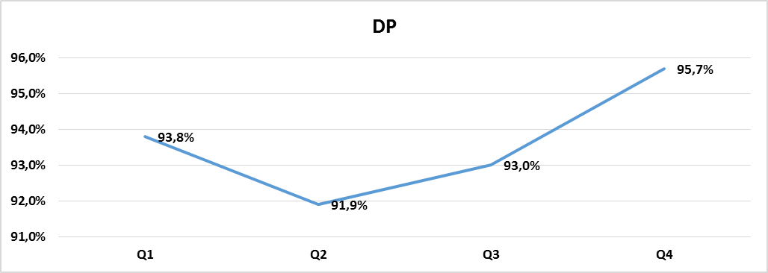
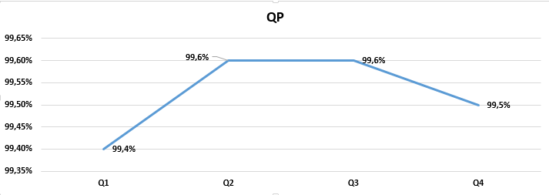
Top 3 spend 2021
DP target 2021: 97% (actual: 93,5%)
QP target 2021: 99,3% (actual: 99,6%)

Slide 10
Breakout room
What parameters do you consider when selecting a factory for your quotes?
And how do you prioritize them?
Share your reflections with your colleagues:
Compare which parameters you consider and your priorities
What good experiences have you had with factory selections?
What bad experiences have you had with factory selections?
Where can data be found to help in factory selection process?
You will be 3x3 and have 10 min.

Slide 11
What parameters is taken into account when picking a factory today?
Customer requirements?
Price?
Performance?
”Tradition”?
Relationship with factory?
Other?

Slide 12
Who picks the factories on all our business?
How does it affect your daily work?

Slide 13
What happens if we focus on lowest price when we pick a factory in a quote and new business?
What other elements are important?

Slide 14
Picking a factory with 97% DP on 1 000 orders means extra contact with Customer, FM and Factory.
Let’s say you spend 30 min on each order on emails and com´s + changes etc in systems.
That’s 15 hours of you working life.
That’s if we meet our target on 97% DP.
If you pick a factory with 90% DP, how much extra work can you expect?

Slide 15
Picking a factory with 97% DP on 1 000 orders means extra contact with Customer, FM and Factory.
Let’s say you spend 30 min on each order on emails and com´s + changes etc in systems.
That’s 15 hours of you working life.
That’s if we meet our target on 97% DP.
If you pick a factory with 90% DP, how much extra work can you expect?
50 hours extra work!
The difference is over a working week, just dealing with delivery problems.
If we all do it on all our 130 000 order lines (2021) we would spend 6 500 hours or 810 working days on just dealing with delivery issues.
That we statistically could expect.

Slide 16
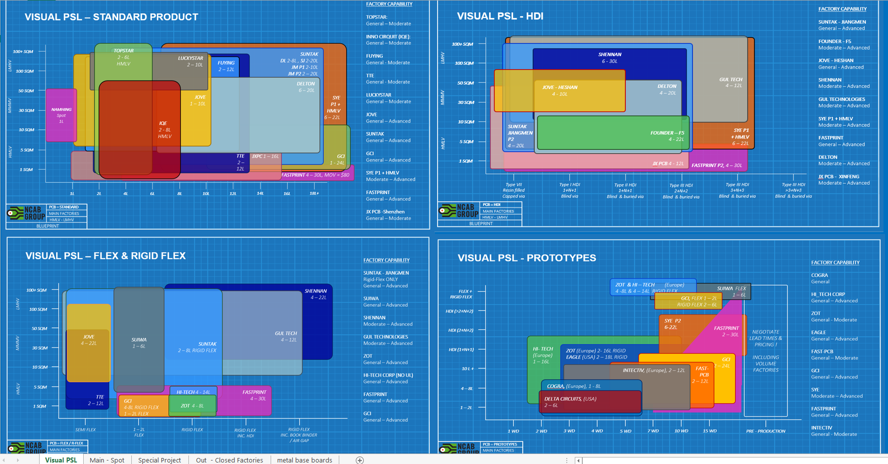

Slide 17
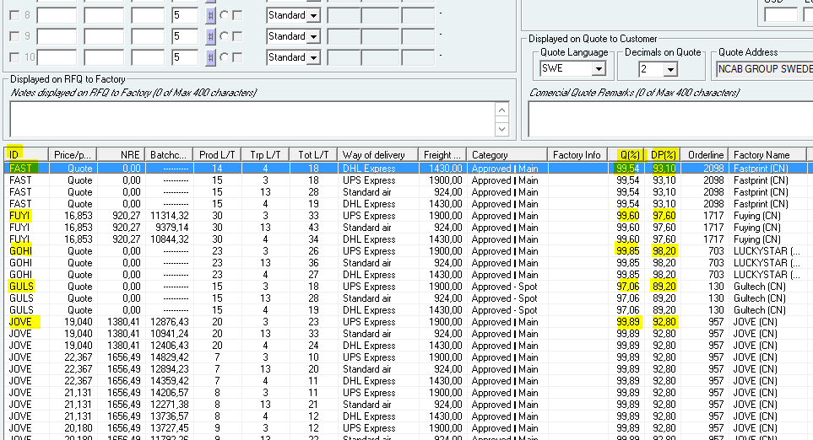
DP and QP in iQuote Factory selection

Slide 18
Quarterly KPI info in PSL

Slide 19
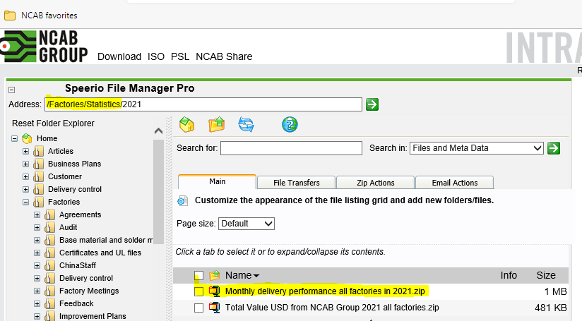
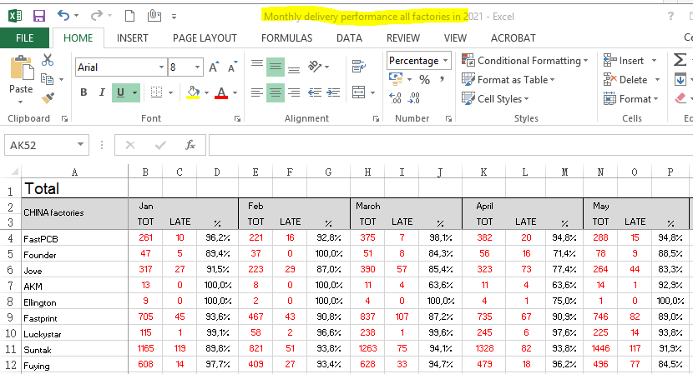
Delivery Performance

Slide 20
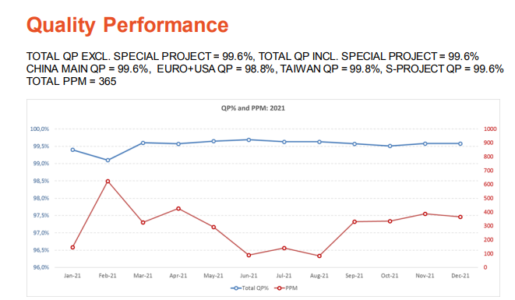
DP and QP in Monthly Report – General and detailed info (check how ”your” factories are doing ☺ )

Slide 21
Correlation between Strong Relationship with Factories and DP / QP from Factories?
?
Which is your favourite factory?
Which is your least favourite factory?
=> Check KPIs in iQuote.
How did they perform last quarter on Delivery Precision, please express as 30min per 100orders
100% Delivery Precision = 0 hours
95% Delivery Precision = 2,5Hours
90% Delivery Precision = 5Hours

Slide 22
Questions?

Slide 23
Break!
Please open My Profile in Sympa > ”Learning & Development” > ”Goals & Coaching”
www.symahr.net/ncab

Slide 24
6L PCB "Standard"
100x150mm | 220 x 170mm panel 2 up
1000pcs Batch | 18,7SQM
Factory | 1 | 2 | 3 | 4 | 5 | 6
USD/Pc | 2,618 | 2,749 | 2,824 | 2,861 | 2,899 | 3,011
Quality | x | x | x | x | x | x
DP | x | x | x | x | x | x

Slide 25
6L PCB "Standard"
100x150mm | 220 x 170mm panel 2 up
1000pcs Batch | 18,7SQM
Factory | 1 | 2 | 3 | 4 | 5 | 6
USD/Pc | 2,618 | 2,749 | 2,824 | 2,861 | 2,899 | 3,011
Quality | 99,77% | 99,89% | 99,66% | 99,60% | 99,61% | 99,53%
DP | x | x | x | x | x | x

Slide 26
6L PCB "Standard"
100x150mm | 220 x 170mm panel 2 up
1000pcs Batch | 18,7SQM
Factory | 1 | 2 | 3 | 4 | 5 | 6
USD/Pc | 2,618 | 2,749 | 2,824 | 2,861 | 2,899 | 3,011
Quality | 99,77% | 99,89% | 99,66% | 99,60% | 99,61% | 99,53%
DP | 98,90% | 99,10% | 97,80% | 97,60% | 97,10% | 93,20%

Slide 27
BREAK OUT ROOM:
Which factory would you pick?
6L PCB "Standard"
100x150mm | 220 x 170mm panel 2 up
1000pcs Batch | 18,7SQM
Factory | 1 | 2 | 3 | 4 | 5 | 6
USD/Pc | 2,618 | 2,749 | 2,824 | 2,861 | 2,899 | 3,011
Quality | 99,77% | 99,89% | 99,66% | 99,60% | 99,61% | 99,53%
DP | 98,90% | 99,10% | 97,80% | 97,60% | 97,10% | 93,20%

Slide 28
What did we pick?
6L PCB "Standard"
100x150mm | 220 x 170mm panel 2 up
1000pcs Batch | 18,7SQM

Slide 29
6L PCB "Standard"
100x150mm | 220 x 170mm panel 2 up
1000pcs Batch | 18,7SQM
Factory | TOPA | IQEL | TTEC | FUYI | JXPC | ELEG
USD/Pc | 2,618 | 2,749 | 2,824 | 2,861 | 2,899 | 3,011
Quality | 99,77% | 99,89% | 99,66% | 99,60% | 99,61% | 99,53%
DP | 98,90% | 99,10% | 97,80% | 97,60% | 97,10% | 93,20%

Slide 30
Which factory would you pick for this project?
PROJECT 1
B-customer OEM
DTAM $400 000
Last 12 month revenue: $150 000
Customer can’t accept any delay
4 LAYER
FR4 1.6mm
Imm Ni/Au
Size 270 x 302.4 mm
2 up
Batch 1 = 16,4 sqm/400 pcs
Batch 2 = 32,8 sqm/800 pcs
30 days LT max
Notes:
Good:
Preparation: You know your red line, check previous quotes etc to learn their red line. Prepares alternatives that fit this customer and ZOPA to go with that. BATNA ready
ZOPA: Let's talk through the details, and surrounding factors. Finds the need! Person, Project, Company.
Never gives anything away w/o something in return
Show consequence: margin, profits, resources, etc?MLN?
ABC/asks for order/next step
=> What did you learn from this? Write in the chat!

Slide 31
Which factory would you pick for this project?
PROJECT 2
A-customer OEM
DTAM $800 000
Last 12 month revenue: $400 000
Customer is giving us a chance to requote this project as not happy with their current supplier QP.
8 LAYER
FR4 Tg150 1.6mm
Imm Ni/Au
Size 270 x 302.4 mm
2 up
Batch 1 = 16,4 sqm/400 pcs
Batch 2 = 32,8 sqm/800 pcs
30 days LT max
Notes:
Good:
Preparation: You know your red line, check previous quotes etc to learn their red line. Prepares alternatives that fit this customer and ZOPA to go with that. BATNA ready
ZOPA: Let's talk through the details, and surrounding factors. Finds the need! Person, Project, Company.
Never gives anything away w/o something in return
Show consequence: margin, profits, resources, etc?MLN?
ABC/asks for order/next step
=> What did you learn from this? Write in the chat!

Slide 32
In summary
You are responsible for building strong relationships with the factories
If a colleague from another company has better relationship with a factory, meet & share experiences with them! (Contact Cecilia if you need support on who buys where)
Use the metrics when taking decisions!
Put your eggs in different baskets!!
You are empowered to take decisions in your daily work life
So, where do you find factory metrics?

Slide 33
REFLECT & SHARE:
How will you select factories going forward, based on what you have learned today?
How will that affect your daily work life?

Slide 34
Next clinic (March 2): ”Validating RFQs & Factory Prices”
In the Program Page (NCAB Academy):
Your feedback about the Clinic (very important!)
Set & complete your SMART-goal
Complete "Lesson 1: Introduction" and "Lesson 2: Validating RFQs" in "Quoting like a Needs Analyst"

Slide 35
My SMART-goal until next time – How will you practice IRL? Crawl – Walk – Run
S
M
A
R
T
PECIFIC
Think about your SMART-goal that you will do until next time.
Write it down in in your Sympa-profile > ”Learning Development” > ”Goals & Coaching”-tab.
We will follow up how it went at the next Clinic.
EASURABLE
CCEPTED
ELEVANT
IME-BOUND

