Slide 1

Focus on Performance
Crawl – Walk – Run
Not just learning,
but doing
OCTOBER
NOVEMBER
DECEMBER
JANUARY
FEBRUARY
MARCH
APRIL
MAY
JUNE
JULY
27
10
24
8
12
9
2
23
13
4
25
14-15
6
1. Start – sales basics
2. USPs
3. Objection handling
4. SPIN
5. Negotiation
6. How to pick
the right factory
7. Validating RFQs
8. Quoting & Gross Margin
9. Quote follow-up
10. Strategic business intelligence
11. Complaint handling
12. Workshop
13. Follow-up
Self-study & SMART-goals
Self Study:
NCAB Academy: Negotiation
SMART-goal
Online Clinics
Offline workshop

Slide 2
Focus on Performance
Crawl – Walk – Run
Not just learning,
but doing
Purpose of clinic
Feel increased confidence in negotiations, where nothing is given away without something in return, and value is created for the customer.
Goal behavior
Uncomfortable & stressed > Confident & listens
My red line > Their red line
Price corridor > Dancefloor/ZOPA
Desperation > Know my red line & BATNA
Drip > Don't drip
OCTOBER
NOVEMBER
DECEMBER
JANUARY
FEBRUARY
MARCH
APRIL
MAY
JUNE
JULY
27
10
24
8
12
9
2
23
13
4
25
14-15
6
1. Start – sales basics
2. USPs
3. Objection handling
4. SPIN
5. Negotiation
6. How to pick
the right factory
7. Validating RFQs
8. Quoting & Gross Margin
9. Quote follow-up
10. Strategic business intelligence
11. Complaint handling
12. Workshop
13. Follow-up
Self-study & SMART-goals
Self Study:
NCAB Academy: Negotiation
SMART-goal
Online Clinics
Offline workshop

Slide 3
Guidelines
Prepare to be present:
    Don’t multitask
    Close your Outlook/e-mail provider and other tabs
Have your phone ready
Get a closed question?
=> Answer with only yes/no
Help each other grow – give feedback

Slide 4
SPIN
What did we learn last time?

Slide 5

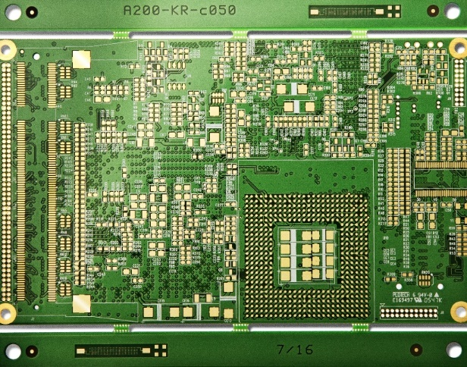



P
I
N
PIN
SITUATION?
What is your situation?
PROBLEM?
What problems is this causing you?
IMPACT?
How does this impact you?
NEEDS?
What do you need?
DEMONSTRATING CAPABILITY
OBTAINING COMMITMENT
OPENING
INVESTIGATING

Slide 6

Breakout room: Follow-up on SMART-goal
Discuss your SMART-goal progress and/or what you have worked/practiced on regarding SPIN since last time:
  How have you practice your new skills?
  How did it go? What was the outcome?
  What have you learned?
You will be 2 persons/room and you have 5 min. (If you haven’t met before, BRIEFLY yourselves

Slide 7

What are the main points in this course?
What did you learn?

Slide 8
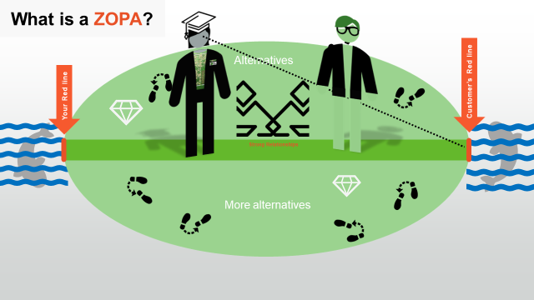
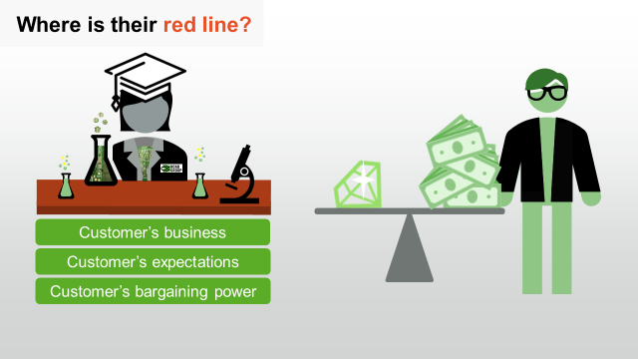
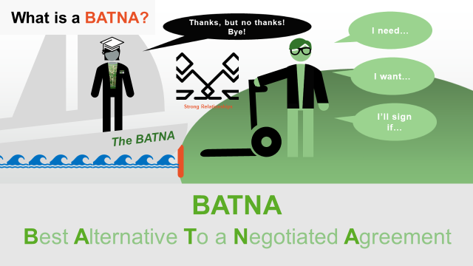
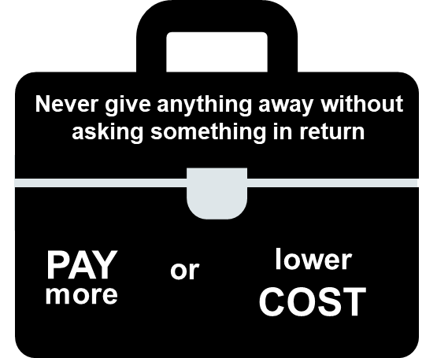
NEGOTIATION CHEAT SHEET
Build strong relationships
& Heed the Need
Show the value that makes
them successful
Never give anything away without asking for something
in return (offer alternatives)
Focus on their red line
Don’t drip!
Use your BATNA
& act with dignity

Slide 9
What question/s are you sitting with right now about Negotiation?

Slide 10
Listen carefully to the following roleplay.
What do you notice?
How can we act instead?
Notes:
Bad:
Preparation: I want to get this deal. I wont go below X% or X GP.
Price corridor: What did you think about the price?
Information: No situational questions to explore ZOPA.
Negotiation: Gives away/drips
Consequence: margin, profits, resources, etc
=> What could we have done instead? Write in chat!

Slide 11
Breakout room
instruction
In your rooms, share & discuss:
What do you usually do to expand your ZOPA in a negotiation?
How do you learn where the customer’s red line is?
You will be 3 people/room and have 10 min.

Slide 12
Listen carefully to the following roleplay.
What do you notice?
NEGOTIATION CHEAT SHEET
Build strong relationships
& Heed the Need
Show the value that makes
them successful
Never give anything away without asking for something
in return (offer alternatives)
Focus on their red line
Don’t drip!
Use your BATNA
& act with dignity
What did you learn here?
Notes:
Good:
Preparation: You know your red line, check previous quotes etc to learn their red line. Prepares alternatives that fit this customer and ZOPA to go with that. BATNA ready
ZOPA: Let's talk through the details, and surrounding factors. Finds the need! Person, Project, Company.
Never gives anything away w/o something in return
Show consequence: margin, profits, resources, etc?MLN?
ABC/asks for order/next step
=> What did you learn from this? Write in the chat!

Slide 13
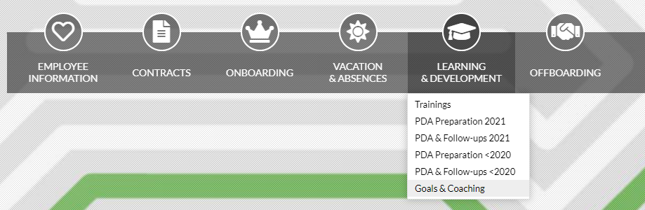
Break!
Please open My Profile in Sympa
> ”Learning & Development”
> ”Goals & Coaching”
www.symahr.net/ncab

Slide 14
Breakout room – Deal or no deal?
instruction
You will soon see 2 different customer counter-offers on a quote from you.
Which of the counter-offers would you accept,
and not accept,
and why?
What would you ask for in return?
What is the BATNA?
You will be 3 people/room and have 10 min.

Slide 15

Customer reply 1:
“We want to buy the PCBs from you but we would like that you waive the start cost and have 3 batches in stock for max 6 months.”
Customer reply 2:
“I have a very tight pre-production plan and would need the first batch in 20 days and the start cost must be waived. If you accept I assign the project to you.”
CUSTOMER INFO
B-customer OEM
DTAM $400 000
Last 12 month revenue:
$110 000
33% Gross Profit
DDP on all freights
30 days Net
No Bonuses
QUOTE INFO
500 pc / batch
16L 1+n+1 HDI
ImAg (Silver)
Std Lead time
Buy: $5 750 / batch
Freight: $288 by Air (57,6 kg)
Total Batch Cost: $6 038
Start cost: $850
Sell price: $9 300 / batch
Gross Profit: $3 262 / batch
Gross Margin: 35%
Start Cost: $1 100
PROJECT INFO
New project
Yearly needs is projected
to grow to 6 000 pc/year
tempo in 6 months
EXERCISE
Which of the customer counter-offers would you accept,
and not accept, and why?
What would you ask for in return?
What is the BATNA?

Slide 16
Customer reply 1:
“We want to buy the PCBs from you but we would like that you waive the start cost and have 3 batches in stock for max 6 months.”
Customer reply 2:
“We are happy to buy from you and develop our business, you are now over 25% of our PCB spend and growing rapidly and we want a bonus scheme of 5% of all our existing and future business to give you the order + 60days net starting from next quarter.”
Customer reply 3:
“We got $16,40 / pc from our main supplier and I’d be happy to give you the order if you can beat that price.”
Customer reply 4:
“I have a very tight pre-production plan and would need the first batch in 20 days and the start cost must be waived. If you accept I assign the project to you.”
CUSTOMER INFO
B-customer OEM
DTAM $400 000
Last 12 month revenue:
$110 000
33% Gross Profit
DDP on all freights
30 days Net
No Bonuses
QUOTE INFO
500 pc / batch
16L 1+n+1 HDI
ImAg (Silver)
High TG FR4
Controlled impedances 10%
Panel: 160 x 240mm
2up: 8mm frame, 2mm routing
Complex routing, V-cut is no option
No X-out
Std Lead time
Buy: $5 750 / batch:
$11,5 / pcs
Freight: $288 by Air (57,6 kg)
Total Batch Cost: $6 038
Start cost: $850
Sell price: $9 300 / batch:
$18,60 / pc
Gross Profit: $3 262 / batch
Gross Margin: 35%
Start Cost: $1 100
PROJECT INFO
New project
Yearly needs is projected
to grow to 6 000 pc/year
tempo in 6 months
EXERCISE
Which of the customer counter-offers would you accept, and not accept, and why?
What would you ask for in return?
What is the BATNA?

Slide 17
Breakout room: Negotiation with customer
instruction
You will soon see a quote you will do a quote follow-up on, and some customer scenarios.
Person 1 = Customer
Person 2 = NCAB
Person 3(+4) = Coach to NCAB
Take a minute to read the quote.
Customer: Pick one of the customer situations (don’t tell which). Don’t give everything away at once!!
NCAB: Start your quote follow-up! Use the cheat-sheet to negotiate.
Roleplay for about 5 min.
Coach: Give feedback to NCAB. Use the cheat-sheet as a checklist.
Rotate!
You will be 3-4 persons per room and you have 20 min.
NEGOTIATION CHEAT SHEET
Build strong relationships
& Heed the Need
Show the value that makes
them successful
Never give anything away without asking for something
in return (offer alternatives)
Focus on their red line
Don’t drip!
Use your BATNA
& act with dignity
Notes:
- Features are facts about NCAB.
- Advantages point out *what the features do.
- Benefits describe why this *could be important for this customer.

Slide 18
Person 1: Customer
1. Customer: Pick one of the customer situations (don’t tell which).
2. NCAB: Start your quote follow-up! Use the cheat-sheet to negotiate.
Roleplay for about 5 min.
3. Coach: Give feedback to NCAB. Use the cheat-sheet as a checklist.
4. Rotate!
Customer 1 | Customer 2 | Customer 3 | Customer 4
Needs 1st batch in 4 weeks. Can pay express if asked Ok to buy if above is met without any further costs. Lots of new project on its way in, Happy to let NCAB have a look at them. Mostly 6 & 8L industry projects. | NCAB ok on price but we want no start cost Wants longer payment terms, pref. 60days Very positive outlook for project. If no start cost and 45days net is met, you can send order. | NCAB lost this project 2 yrs ago, but current supplier has bad DP NCAB are 4,2% more expensive, but ask for 9,7%. You can accept offer as is if NCAB asks for it. You want at least one batch as Consignment stock for 3 month. You are then happy to give firm order for full year. | You want to see the sustainability audit NCAB performed of quoted factory Current supplier has huge problems and you can accept 800USD/batch but you ask for 7% cost down You are happy to order as quoted as long as the factory was Audited last 3 years. You risk to loos the project and need help on Sustainability knowledge.

Slide 19
Person 2: NCAB
1. Customer: Pick one of the customer situations (don’t tell which).
2. NCAB: Start your quote follow-up! Use the cheat-sheet to negotiate.
Roleplay for about 5 min.
3. Coach: Give feedback to NCAB. Use the cheat-sheet as a checklist.
4. Rotate!
Quote
New part
Worth $670 / batch
4 batches / year
$270 in Gross Profit / batch
Suntak 8L std build
Leadtime 7 weeks
Payment terms 30 days
NEGOTIATION CHEAT SHEET
Build strong relationships
& Heed the Need
Show the value that makes
them successful
Never give anything away without asking for something
in return (offer alternatives)
Focus on their red line
Don’t drip!
Use your BATNA
& act with dignity

Slide 20
Negotiation with factory – Part 1
Listen carefully to the following roleplay.
What do you notice?
What did you learn?
Notes:
Bad:
Preparation: I want to get this deal. I wont go below X% or X GP.
Price corridor: What did you think about the price?
Information: No situational questions to explore ZOPA.
Negotiation: Gives away/drips
Consequence: margin, profits, resources, etc
=> What could we have done instead? Write in chat!

Slide 21
Negotiation with factory – Part 2
Listen carefully to the following roleplay.
What do you notice?
What did you learn?
Notes:
Bad:
Preparation: I want to get this deal. I wont go below X% or X GP.
Price corridor: What did you think about the price?
Information: No situational questions to explore ZOPA.
Negotiation: Gives away/drips
Consequence: margin, profits, resources, etc
=> What could we have done instead? Write in chat!

Slide 22
Negotiating with factories – some tips
Always negotiate the most important aspect first
Always negotiate on price!
Use uneven numbers (7,3%, 9,6%) when asking for a discount
Be clear: “I need $3,53/pc to be able to go forward”
Invite to solve: “I would like you to have this project, but first you must help me to win it”
Remember: Buying smart is equally important as selling!
Use friendly pressure: “If you can´t meet the needs, I have to check with our other factories”
… Do you have any other tips?

Slide 23
What is the main thing you learned today?
Write in the chat!

Slide 24
Focus on Performance
Crawl – Walk – Run
Not just learning,
but doing
Purpose of clinic
Feel increased confidence in negotiations, where nothing is given away without something in return, and value is created for the customer.
Goal behavior
Uncomfortable & stressed > Confident & listens
My red line > Their red line
Price corridor > Dancefloor/ZOPA
Desperation > Know my red line & BATNA
Drip > Don't drip
OCTOBER
NOVEMBER
DECEMBER
JANUARY
FEBRUARY
MARCH
APRIL
MAY
JUNE
JULY
27
10
24
8
12
9
2
23
13
4
25
14-15
6
1. Start – sales basics
2. USPs
3. Objection handling
4. SPIN
5. Negotiation
6. How to pick
the right factory
7. Validating RFQs
8. Quoting & Gross Margin
9. Quote follow-up
10. Strategic business intelligence
11. Complaint handling
12. Workshop
13. Follow-up
Self-study & SMART-goals
Self Study:
NCAB Academy: Negotiation
SMART-goal
Online Clinics
Offline workshop

Slide 25
Next clinic (Feb 9): ”How to pick the right factory” with Cecilia Snell, GF
In the Program Page (NCAB Academy):
Your feedback about the Clinic (very important!)
Set & complete your SMART-goal

Slide 26
My SMART-goal until next time – How will you practice IRL?
Crawl – Walk – Run
S
M
A
R
T
PECIFIC
Think about your SMART-goal that you will do until next time.
Write it down in in your Sympa-profile
> ”Learning Development”
> ”Goals & Coaching”-tab.
We will follow up how it went at the next Clinic.
EASURABLE
CCEPTED
ELEVANT
IME-BOUND

