Slide 1

Focus on Performance
Crawl – Walk – Run
Not just learning,
but doing
OCTOBER
NOVEMBER
DECEMBER
JANUARY
FEBRUARY
MARCH
APRIL
MAY
JUNE
JULY
27
10
24
8
12
9
2
23
13
4
25
14-15
6
1. Start – sales basics
2. USPs
3. Objection handling
4. SPIN
5. Negotiation
6. How to pick
the right factory
7. Validating RFQs
8. Quoting & Gross Margin
9. Quote follow-up
10. Strategic business intelligence
11. Complaint handling
12. Workshop
13. Follow-up
Self-study & SMART-goals
Self Study:
NCAB Academy: SPIN
SMART-goal
Online Clinics
Offline workshop

Slide 2
Guidelines
Prepare to be present:
    Don’t multitask
    Close your Outlook/e-mail provider and other tabs
Have your phone ready
Get a closed question?
=> Answer with only yes/no
Help each other grow – give feedback

Slide 3
Today’s agenda
SMART-goal follow-up
SPIN!!!!!
SMART goal until next time
Next module

Slide 4
OBJECTION HANDLING
What did we learn last time?

Slide 5
How do we handle objections in NCAB?
OBJECTION HANDLING CHECKLIST
Lean in – Acknowledge & Recognize
Investigate
  Heed the Need – what are their true needs?
  Open questions
Offer specific benefits (not general features)
  How does it make the customer successful?
ABC – Agree on next step

Slide 6

Breakout room: Follow-up on SMART-goal
Discuss your SMART-goal progress and/or what you have worked/practiced on regarding Objection handling since last time:
  How have you practice your new skills?
  How did it go? What was the outcome?
  What have you learned?
You will be 2 persons/room and you have 5 min. (If you haven’t met before, BRIEFLY yourselves

Slide 7
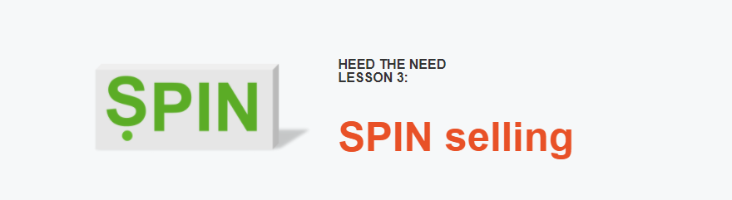
What are the main points in this lesson?
What did you learn?

Slide 8

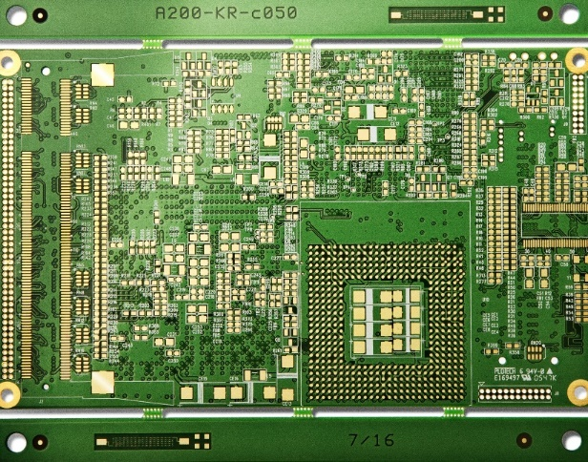




WHY?
P
I
N
PIN
SITUATION?
What is your situation?
PROBLEM?
What problems is this causing you?
IMPACT?
How does this impact you?
NEEDS?
What do you need?
DEMONSTRATING CAPABILITY
OBTAINING COMMITMENT
OPENING
INVESTIGATING

Slide 9
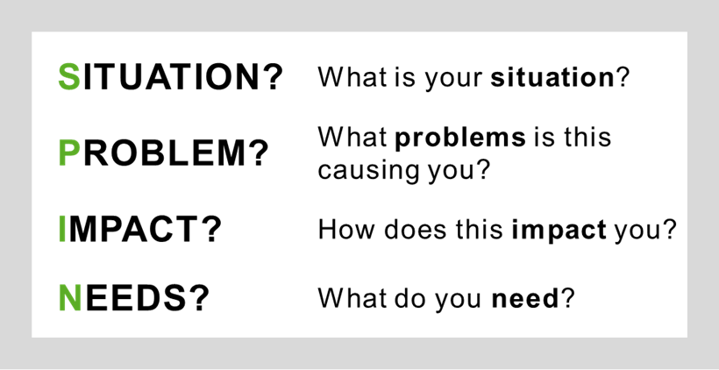
Listen carefully to the following roleplay. What do you notice?
SITUATION:
What would you like to get out of today’s visit?
Please tell me about your situation?
What’s your current car situation?
When do you plan to change the cars?
PROBLEM:
What kind of problems does this cause you?
IMPACT:
How does this impact you?
NEEDS:
So what do you need?

Slide 10
Roleplay! Part 2
Listen carefully to the following roleplay.
What do you notice?
Write it down.

Slide 11
What question/s are you sitting with right now about SPIN?

Slide 12
Breakout room: SPIN practice 1
instruction
I feel very stressed at work.
I feel very stressed at work.
Maybe you should try yoga?
Maybe you should try yoga?
S: Why are you stressed?
You will soon see a list of everyday situations.
Person 1 = Person who needs help
Person 2 = SPINner
Person 1: Pick one of the situations that is most relevant to you, or make up your own situation where you need help.
Person 2: Use SPIN on the situation to help discover Person 1’s need/s.
Ask 1 question per SPIN-step.
When the SPIN-process is complete, switch.
You will be 2 persons per room and you have 10-12 min.
S: Please tell me about your situation?
P: How are you coping with your deadlines?
P: What problems is this causing you?
I: How does this impact your sleep?
I: How does this impact you?
N: What can we do to make you feel less stressed?
N: What do you need to feel less stressed?
Notes:
- Features are facts about NCAB.
- Advantages point out *what the features do.
- Benefits describe why this *could be important for this customer.

Slide 13
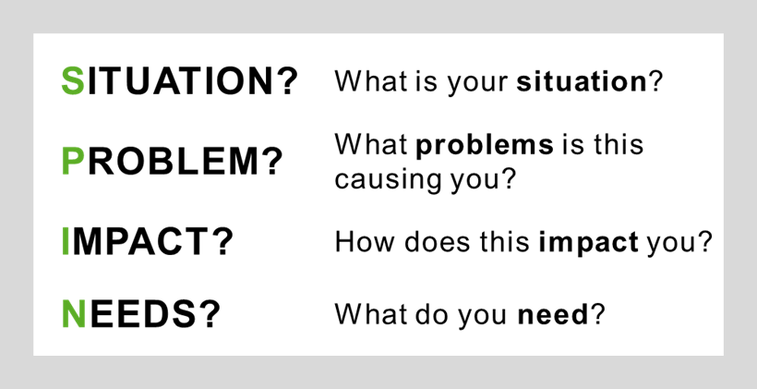

Person 1: Pick 1 of the situations below that you need help with (or make up your own).
Person 2: Ask 1 question per SPIN-step to discover the need/s.
Rotate. (10-12 min)
I’m stressed
I don’t know what to cook for dinner
I have difficulties doing quote follow-ups
I need a new hobby
I need to start exercising
…or something else?
SITUATION?
What is your situation?
PROBLEM?
What problems is this causing you?
IMPACT?
How does this impact you?
NEEDS?
What do you need?

Slide 14
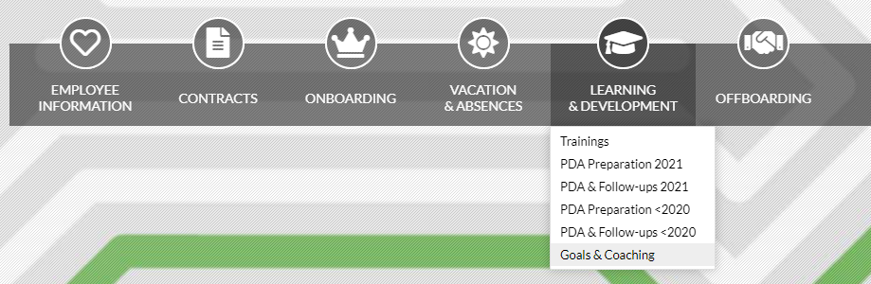
Break!
Please open My Profile in Sympa
> ”Learning & Development”
> ”Goals & Coaching”
www.symahr.net/ncab

Slide 15
Breakout room: SPIN practice 2
instruction
I need to eat healthy.
S: How come you feel you need to do that?
You will soon see a list of everyday situations.
Person 1 = Person who needs help
Person 2 = SPINner
Person 3(+4) = Coach to the SPINner
Person 1: Pick one of the situations that is most relevant to you,
or make up your own situation where you need help.
Person 2: Use SPIN on the situation to help discover Person 1’s need/s.
Ask 2-3 questions per SPIN-step.
Coach: Give feedback to the SPINner on each SPIN-step (S+P+I+N).
When the SPIN-process is complete, rotate.
You will be 3-4 persons per room and you have 20 min.
Here is a nice salad recipe!
S: What has your doctor told you?
S: When do you need to start?
P: What problems do your current diet cause you?
Notes:
- Features are facts about NCAB.
- Advantages point out *what the features do.
- Benefits describe why this *could be important for this customer.

Slide 16
Person 1: Pick 1 of the situations below that you need help with (or make up your own).
Person 2: Ask 2-3 questions per SPIN-step to discover the need/s.
Person 3(+4): Coaches P2.
Rotate. (20 min)
I need to start exercising
I want to buy a new car
I have no TV show to watch right now
I’m not happy with my current hairspray
I have nothing to wear to the party tonight
…or something else?
Situation?
Problem?
Impact?
Needs?

Slide 17
Breakout room: SPIN roleplay!
instruction
We are struggling with leadtimes at the moment.
Person 1 = Customer
Person 2 = NCAB
Person 3(+4) = Coach to the NCAB salesperson
Customer: Pick one of the situations and act accordingly.
NCAB: Use SPIN to find out the customer’s needs.
Try to ask 3-5 questions for each SPIN-step.
When the SPIN is finished: Come up with 3-4 NCAB USPs/customer benefits that fit this customer.
Coach: Give feedback to NCAB on each SPIN-step.
When the SPIN-process is complete, rotate.
You will be 3-4 per room and have 25-30 min.
(S) How long has this been going on?
During the last year.
(S) How long are the leadtimes?
2-3 week delays.
(S) What is causing this?
Notes:
- Features are facts about NCAB.
- Advantages point out *what the features do.
- Benefits describe why this *could be important for this customer.

Slide 18
INSTRUCTION
Person 1 = Customer
Person 2 = NCAB
Person 3(+4) = Coach to the NCAB salesperson
Customer: Pick one of the situations and act accordingly.
NCAB: Use SPIN to find out the customer’s needs. Try to ask 3-5 questions for each SPIN-step.
When the SPIN is finished: come up with 3-4 NCAB USPs/customer benefits that fit this customer.
Coach: Give feedback to NCAB on each SPIN-step.
When the SPIN-process is complete, rotate.
CUSTOMER SITUATIONS
”Can you do fast turn?”
”Do you have design support?”
”Can you do express shipments?”
”Do you deal with Suntak?”
”Do you ship by boat?”
”Do you do HDI boards?”
Situation?
Problem?
Impact?
Needs?

Slide 19
What is the main thing you learned today?
Write in the chat!

Slide 20
Next clinic (Jan 12): Negotiation with Benjamin Klingenberg, NCAB Germany
In NCAB Academy:
Your feedback about the Clinic (very important!)
Complete NCAB Academy-course ”Negotiation”
Set & complete your SMART-goal

Slide 21
My SMART-goal until next time – How will you practice IRL?
Crawl – Walk – Run
S
M
A
R
T
PECIFIC
Think about your SMART-goal that you will do until next time.
Write it down in in your Sympa-profile
> ”Learning Development”
> ”Goals & Coaching”-tab.
We will follow up how it went at the next Clinic.
EASURABLE
CCEPTED
ELEVANT
IME-BOUND

