Slide 1
Focus on Performance Crawl – Walk – Run
Not just learning, but doing
OCTOBER
NOVEMBER
DECEMBER
JANUARY
FEBRUARY
MARCH
APRIL
MAY
JUNE
JULY
27
10
24
8
12
9
2
23
13
4
25
14-15
6
1. Start – sales basics
2. USPs
3. Objection handling
4. 3 Ps + Time mgmt
5. Negotiation
6. How to pick the right factory
7. Validating RFQs & SPIN
8. Quoting & Gross Margin
9. Quote follow-up
10. Strategic business intelligence
11. Complaint handling
12. Workshop
13. Follow-up
Self-study & SMART-goals
Self Study:
NCAB Academy: Getting through
SMART-goal
Online Clinics
Offline workshop

Slide 2
Program Performance Path
LEARNING OUTCOMES
The knowledge/skills the program intends to create
MOMENTS THAT MATTER
Scenarios where “Learning Outcomes” can be used to create a result (“Performance Outcomes”)
PERFORMANCE OUTCOMES
A result/achievement that an application of “Moments That Matters“ can give/create
BUSINESS RATIONALE
Why “Performance Outcomes” are important – the business/individual goals that “Performance Outcomes” contribute to
Understands the key elements and how to apply the Heed the Need-mindset throughout the sales process
Understand how to build strong customer relationships
Understands how different sales tools create professionalism and success, and how/when to use them (open questions, ABC, SPIN, ZOPA, BATNA, CHRIS, etc.)
Understand the importance of calling the customer
Ability to understand & argue for NCABs added values and USPs, and how NCAB differs from other suppliers
Ability to calculate healthy profits
Ability to identify high opportunity customers and projects (Conscious Quoting)
Ability to successfully follow up on high opportunity quotes, and agree on the next step
Understands how & why to use our systems efficiently in the sales process
Gets clarity in daily processes and decisions, and the opportunities that exist
Ability to use one’s Learning Mindset
Understands the importance of and ability to give feedback to colleagues
Calls the customer throughout the sales process, using the sales tools to Heed the Need and helping the customer
Ensures long- and/or short term next steps in all customer contacts
Sets prices adapted to the customer, and calculates & ensures healthy profits on all quotes
Validates all RFQs
Performs quote analysis before quoting, ensuring a clear added value (Conscious Quoting)
Sets & follows an efficient quote follow-up routine, where high opportunity quotes are prioritized
Uses our systems to streamline processes and take strategic decisions
Actively negotiates with customer and factory
Leans in to the customer when complaints occur
Handles objections successfully and with confidence
Continuously feedbacks colleagues to support their growth, being a role model
Grows in security, confidence and boldness in the role
Increased number of “Strong Relationship”-customers
Higher win-rate on high opportunity customers
Higher Gross Margin and profit
Higher order line value
Higher Team Efficiency Index
Increased Customer Satisfaction Index & cNPS
Increased number of part-numbers
Less quotes to low-opportunity customers
Less/stagnation of number of quotes
Less complaints / quality issues
Best Customer Service/Support in our industry
Top-engaged employees in our industry
Long-term growth
High, stable quality performance
High, stable delivery performance
Higher order intake
Higher revenue
Increased global Customer Satisfaction Index and cNPS
High employee attraction rate among top talents in the industry

Slide 3
Guidelines
Prepare to be present:
Don’t multitask
Close your Outlook/e-mail provider and other tabs
Have your phone ready
Get a closed question? => Answer with only yes/no
Help each other grow – give feedback

Slide 4
Today’s agenda
SMART-goal follow-up
Our USPs – referesher
How to handle objections
SMART goal until next time
Next clinic

Slide 5
OUR USPS What did we learn last time?

Slide 6
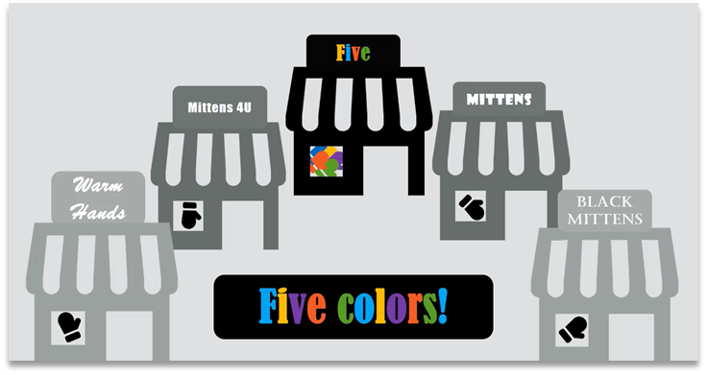
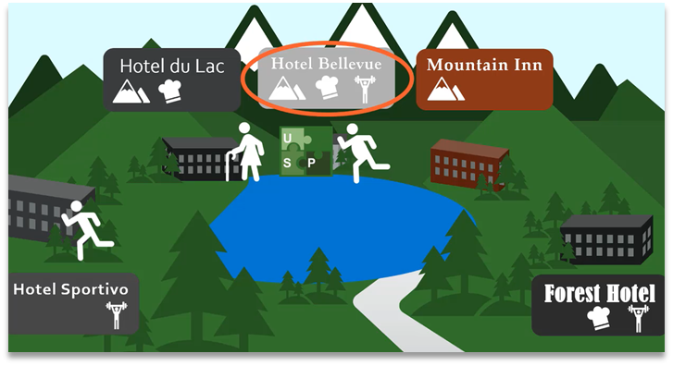

Slide 7
What are your questions?

Slide 8
Breakout room: Follow-up on SMART-goal
Discuss your SMART-goal progress and/or what you have worked/practiced on regarding Our USPs since last time:
How have you practice your new skills?
How did it go? What was the outcome?
What have you learned?
You will be 2 persons/room and you have 5 min. (If you haven’t met before, BRIEFLY yourselves (30 s/person))

Slide 9
What do you think about objections?

Slide 10
How do we handle objections in NCAB?
Lean in – Acknowledge & Recognize (“thank you…”)
Investigate
Heed the Need – what are their true needs?
Open questions
Offer specific benefits (not general features)
How does it make the customer more successful?
ABC – Agree on next step
And also
Don’t get stuck in the defence trap
Be graceful in defeat – ABC

Slide 11
Roleplay! Part 1
Listen carefully to the following roleplay.
What do you notice? Write it down.

Slide 12
Roleplay! Part 2
Listen carefully to the following roleplay.
What do you notice? Write it down.
OBJECTION HANDLING CHECKLIST
Lean in – Acknowledge & Recognize
Investigate
Heed the Need – what are their true needs?
Open questions
Offer specific benefits (not general features)
How does it make the customer successful?
ABC – Agree on next step

Slide 13
What question/s are you sitting with right now about objections?

Slide 14
Breakout room: Objection handling
instruction
You will soon see a list of common objections from ”real life”. Do a quick roleplay on them using the Objection handling-checklist!
If you haven’t met before, BRIEFLY introduce yourselves (30 s/person).
Person 1 reads one objection
Person 2 responds to the objection based on the Objection handling-checklist
Then switch!
You will be 2 persons per room and you have 7 min.
OBJECTION HANDLING CHECKLIST
Lean in – Acknowledge & Recognize
Investigate
Needs Analyst – what are their true needs?
Open questions
Offer specific benefits
How does it make the customer more successful?
ABC – Agree on next step
Notes:
- Features are facts about NCAB. - Advantages point out *what the features do. - Benefits describe why this *could be important for this customer.

Slide 15
Objection handling
(To employee in a clothing store) “These pants don’t look good on me!”
(To sales person in a telemarketer call) “I am happy with my current supplier”
(To waiter at a restaurant) “I don’t know what to get…”
(To the hairdresser) “I don’t think I need to buy any more hair products…”
(To a charity ambassador on the street) “No, I already donate every month”
OBJECTION HANDLING CHECKLIST
Lean in – Acknowledge & Recognize
Investigate
Needs Analyst – what are their true needs?
Open questions
Offer specific benefits (not general features)
How does it make the customer successful?
ABC – Agree on next step

Slide 16
Break!
Please open My Profile in Sympa > ”Learning & Development” > ”Goals & Coaching”
www.symahr.net/ncab

Slide 17
What are your most difficult objections to handle?
…
…
…
…
…
OBJECTION HANDLING CHECKLIST
Lean in – Acknowledge & Recognize
Investigate
Needs Analyst – what are their true needs?
Open questions
Offer specific benefits (not general features)
How does it make the customer successful?
ABC – Agree on next step
Notes:
Who in the audience would like to try?
Mini-roleplay 2-3 min
Feedback according to the cheat sheet

Slide 18
Breakout room: Objection handling
instruction
You will soon see a list of common objections from customers.
Person 1 = Customer Person 2 = NCAB (=longest employment at NCAB) Person 3(+4) = Coach to NCAB
If you haven’t met before, BRIEFLY introduce yourselves (30 s/person)
Customer reads one objection to NCAB.
NCAB responds to the objection based on the Objection handling-checklist (focus on step 1-2)
The Coach gives feedback to the NCAB salesperson on each objection, based on the Objection handling-checklist.
Rotate.
You will be 3-4 persons per room and you have 15-20 min.
OBJECTION HANDLING CHECKLIST
Lean in – Acknowledge & Recognize
Investigate
Needs Analyst – what are their true needs?
Open questions
Offer specific benefits
How does it make the customer more successful?
ABC – Agree on next step
We prefer to use local prototype factory
Notes:
- Features are facts about NCAB. - Advantages point out *what the features do. - Benefits describe why this *could be important for this customer.

Slide 19
Person 1 = Customer and reads objection Person 2 = NCAB and responds according to Objection handling-checklist Person 3(+4) = Coaches on objection based on Objection handling-checklist Then rotate. (15-20 min)
Your price is 12% higher than other options
Your lead time is 2 weeks longer than others
Why do I have to wait for your quotes for so long?
You are 25% more expensive than if I buy from another trader at the same factory
We prefer to use local prototype factory
You cannot do QTA times of less than 3 days
Your order acknowledgement takes too long
I can’t accept any delays – will you promise me they will be on time?
We work direct with China with more competitive prices
Why do you ask so many questions?
Your Eqs take too long
Your pricing is too high
We’ve already worked with NCAB once and it didn’t go well
OBJECTION HANDLING CHECKLIST
Lean in – Acknowledge & Recognize
Investigate
Needs Analyst – what are their true needs?
Open questions
Offer specific benefits
How does it make the customer more successful?
ABC – Agree on next step

Slide 20
Breakout room: One more time!
instruction
You will soon see a list of common objections from customers.
Person 1 = Customer Person 2 = NCAB (=shortest employment at NCAB) Person 3(+4) = Coach to NCAB
If you haven’t met before, BRIEFLY introduce yourselves (30 s/person)
Customer reads one objection to NCAB
NCAB responds to the objection based on the Objection handling-checklist (focus on all steps this time!)
The Coach gives feedback to the NCAB salesperson on each objection, based on the Objection handling-checklist.
Rotate.
You will be 3-4 persons per room and you have 15-20 min.
OBJECTION HANDLING CHECKLIST
Lean in – Acknowledge & Recognize
Investigate
Needs Analyst – what are their true needs?
Open questions
Offer specific benefits (not general features)
How does it make the customer successful?
ABC – Agree on next step
We prefer to use local prototype factory
Notes:
- Features are facts about NCAB. - Advantages point out *what the features do. - Benefits describe why this *could be important for this customer.

Slide 21
Person 1 = Customer and reads 3 objections Person 2 = NCAB and responds to the objections Person 3(+4) = Coaches on each objection. Then rotate. (15 min)
Your lead time is too long
Why is your price not competitive?
Your are too slow on quoting
Our customer prefers another PCB supplier
We had a quality issue with you before and lost a customer. We will not use you again.
Your pricing 20% higher for the same product and service
Your competitor is much cheaper
Your lead times are much higher
You lack materials
How is it possible that sometimes we receive pieces with some defects, or in delay, despite you have people who control the progress of our orders on the production lines?
How is possible that a supplier with a strong presence in China, like you are, can't reserve some laminate on stock for us?
(Following actual raw material price increase) We received increase price only from NCAB!
OBJECTION HANDLING CHECKLIST
Lean in – Acknowledge & Recognize
Investigate
Needs Analyst – what are their true needs?
Open questions
Offer specific benefits (not general features)
How does it make the customer more successful?
ABC – Agree on next step

Slide 22
My SMART-goal until next time – How will you practice IRL? Crawl – Walk – Run
S
M
A
R
T
PECIFIC
“I will use ONLY open questions in my next 5 conversations.”
“I will get better at using open questions.”
“I will get better at using open questions.”
EASURABLE
CCEPTED
“I will start closing more often.”
“I will use ABC in all my customer calls until the next clinic on November XX.“
“I will start closing more often.”
ELEVANT
IME-BOUND

Slide 23
My SMART-goal until next time – How will you practice IRL? Crawl – Walk – Run
S
M
A
R
T
PECIFIC
Think about your SMART-goal that you will do until next time.
Write it down in in your Sympa-profile > ”Learning Development” > ”Goals & Coaching”-tab.
We will follow up how it went at the next Clinic.
EASURABLE
CCEPTED
ELEVANT
IME-BOUND

Slide 24
Next clinic (Dec 8): SPIN
In NCAB Academy:
Complete SPIN
Set & complete your SMART-goal

