Slide 1
Focus on Performance Crawl – Walk – Run
Not just learning, but doing
OCTOBER
NOVEMBER
DECEMBER
JANUARY
FEBRUARY
MARCH
APRIL
MAY
JUNE
JULY
27
10
24
8
12
9
2
23
13
4
25
14-15
6
1. Start – sales basics
2. USPs
3. Objection handling
4. 3 Ps + Time mgmt
5. Negotiation
6. How to pick the right factory
7. Validating RFQs & SPIN
8. Quoting & Gross Margin
9. Quote follow-up
10. Strategic business intelligence
11. Complaint handling
12. Workshop
13. Follow-up
Self-study & SMART-goals
Self Study:
NCAB Academy: Our USPs
Personal Performance Path
SMART-goal
Read company presentation/website
Online Clinics
Offline workshop

Slide 2
Guidelines
Camera on during the whole time
Be active & present in the Breakout rooms
Sit by yourself (one computer per person)
Prepare to be present:
Don’t multitask
Close your Outlook/e-mail provider and other tabs
Have your phone ready
Get a closed question? => Answer with only yes/no
Help each other grow – give feedback

Slide 3
Today’s agenda
SMART-goal follow-up
Our USPs
Features vs. Benefits
Break!
How to respond to a price discussion
SMART goal until next time
Next module

Slide 4
SALES BASICS: HEED THE NEED, OPEN & CLOSED QUESTIONS, ABC What did we learn last time?

Slide 5
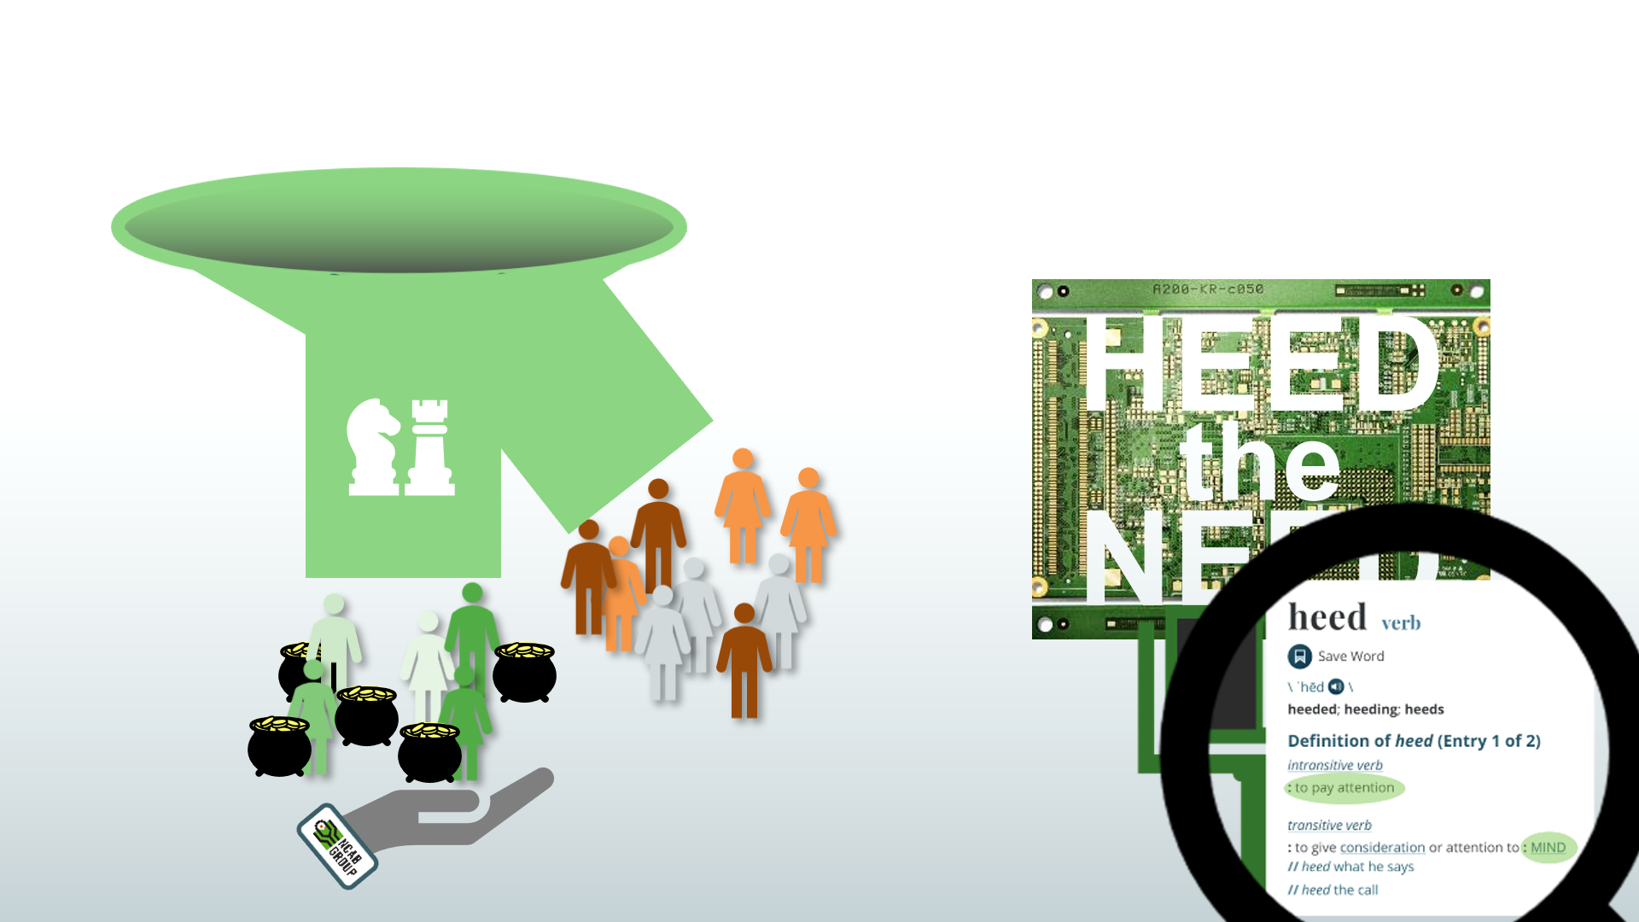
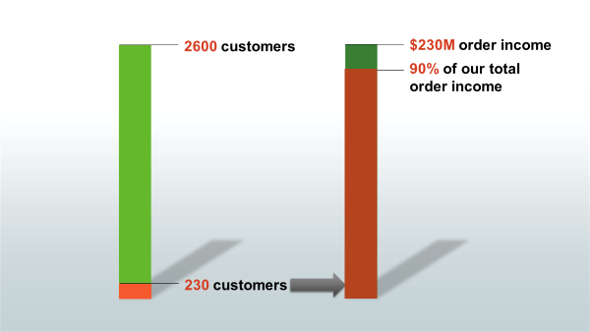
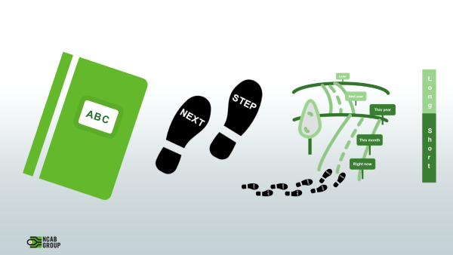

Slide 6
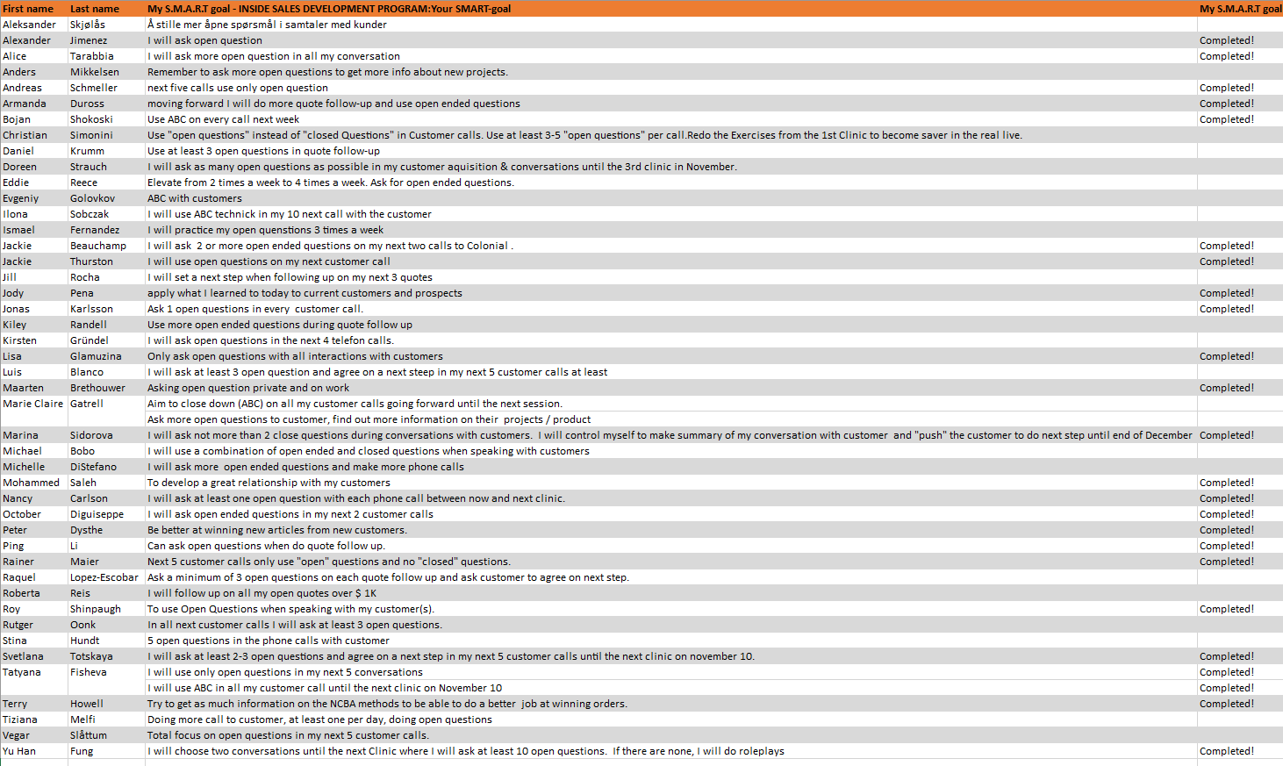
Breakout room: Follow-up on SMART-goal
Discuss your SMART-goal progress and/or what you have worked/practiced on regarding Sales Basics / Open & Closed Questions / ABC since last time:
How have you practice your new skills?
How did it go? What was the outcome?
What have you learned?
You will be 2 persons/room and you have 5 min.

Slide 7
What are the main points in the course?
What did you learn?

Slide 8
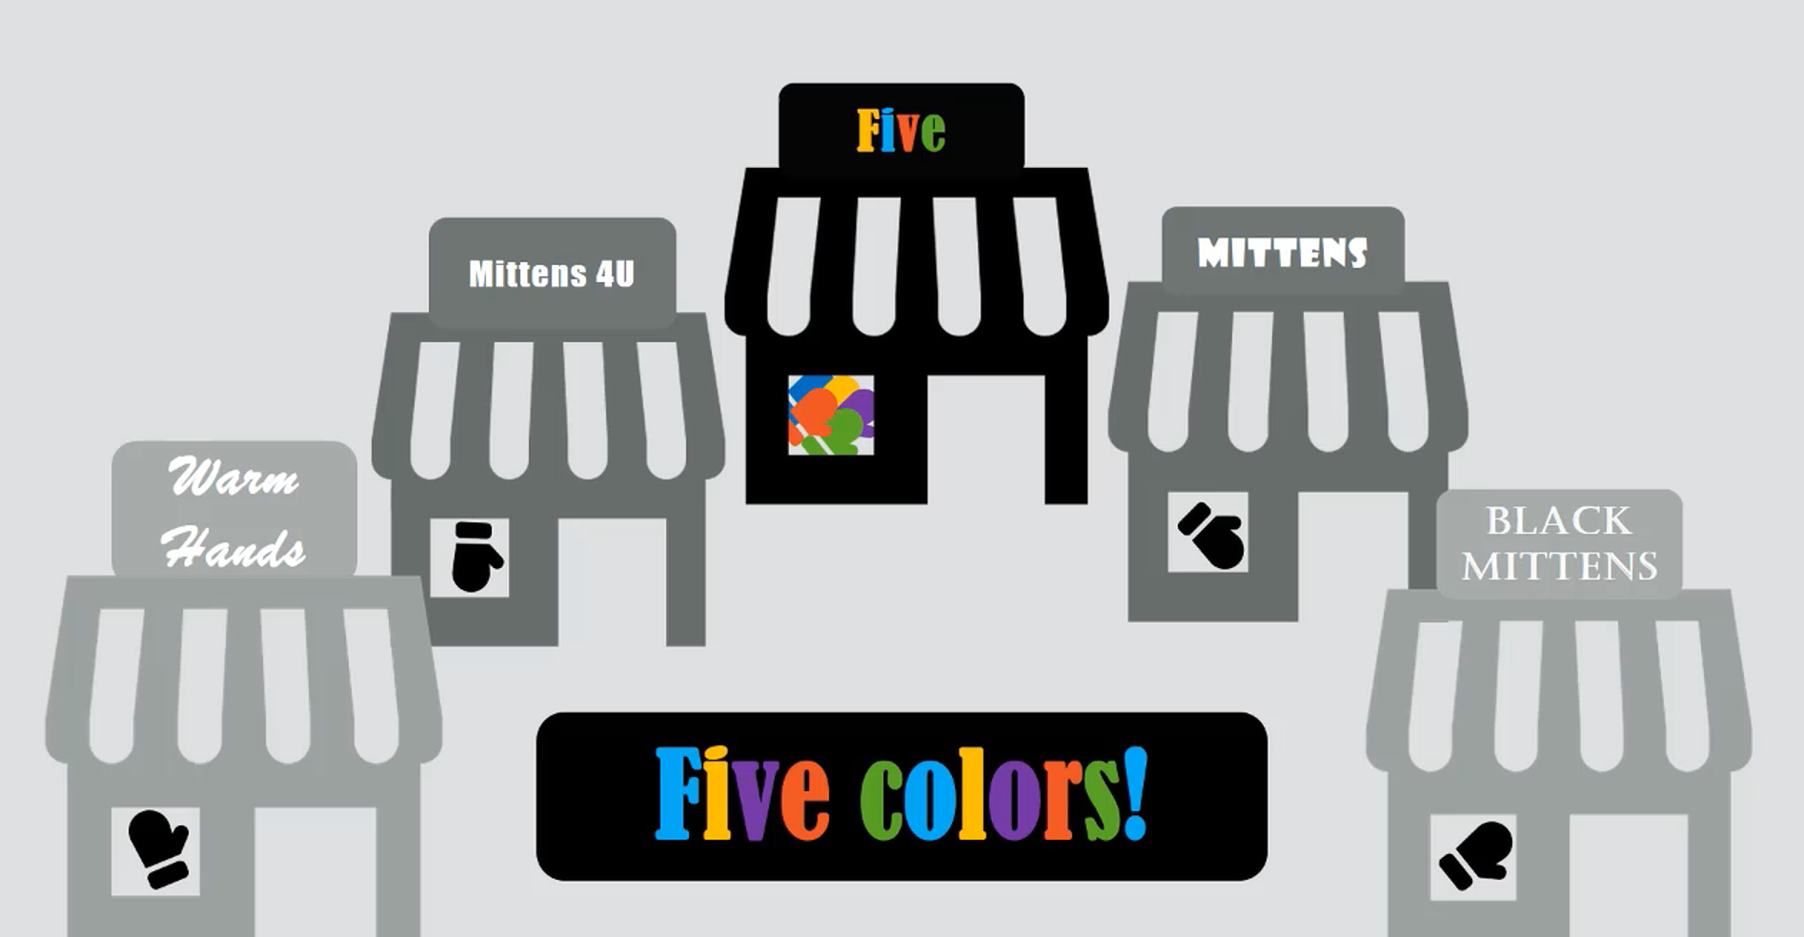
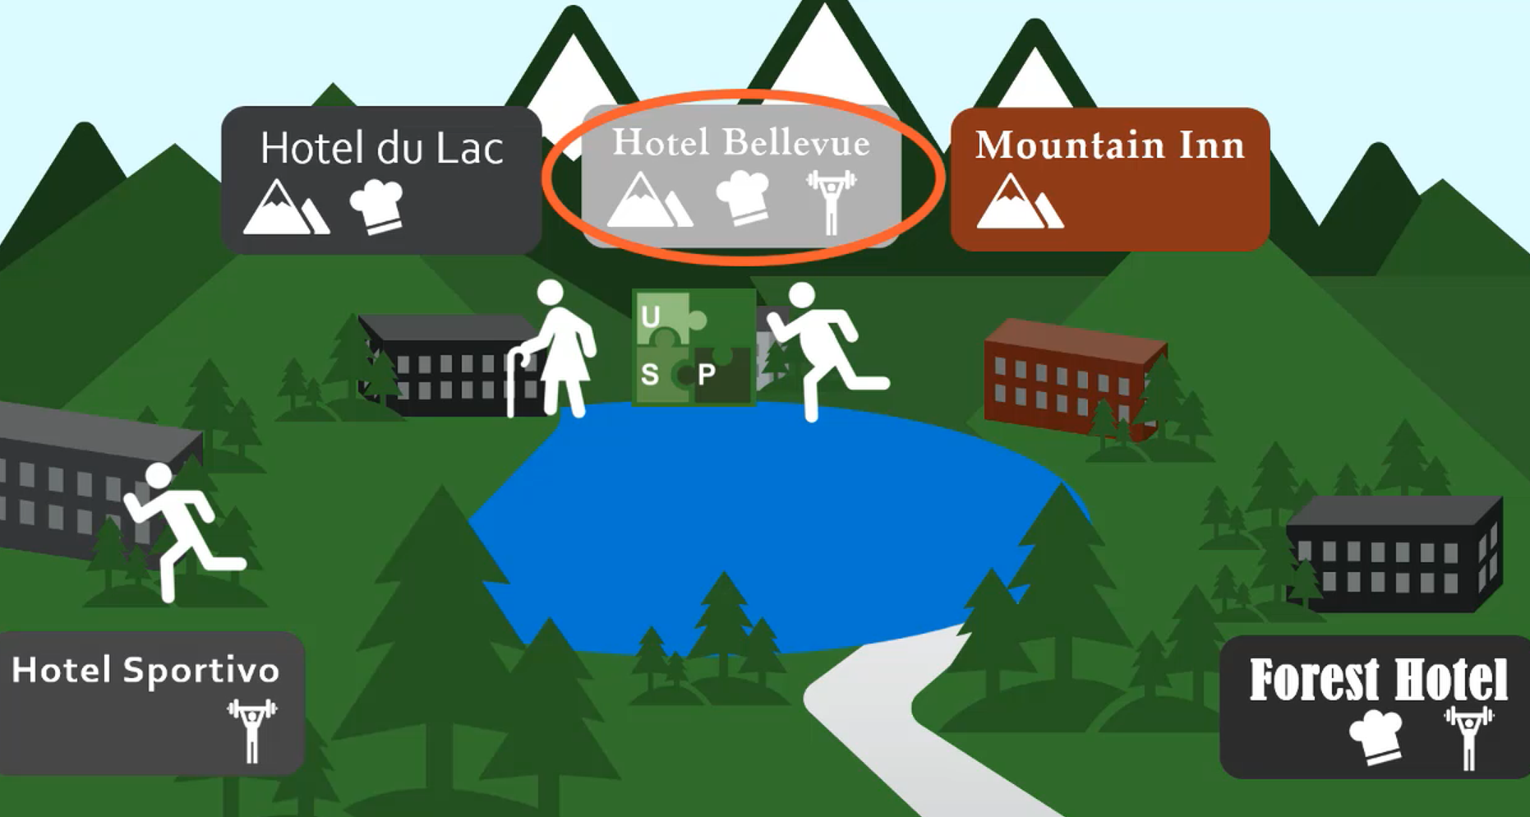
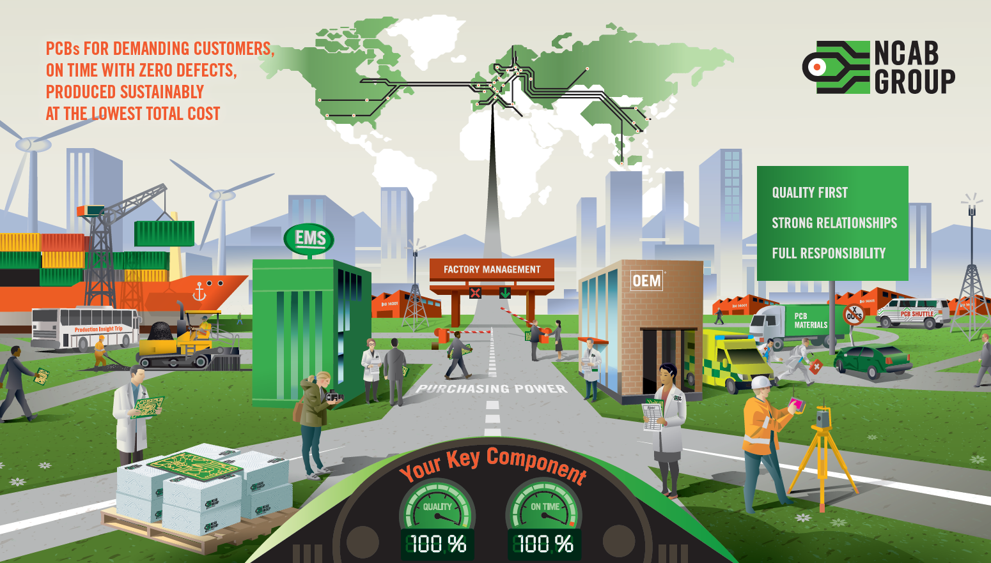
Notes:
USP CLASS RECAP
You’ve all seen the class recently, so I’m not gonna spend to much time on the course itself, but some things are worth to remember
When all are alike, you go for the price.
If you offer something more, that is unique = the price is less important
And a simple USP is usually simple to copy, making it all start over again
For us at NCAB, our competitors come in very different shapes. Having our own staff in factories can be unique compared to traders, but not compared to factories. Our local sale office is unique compared to factories, but not compared to traders.
And PCBs are definitely more complicated than mittens, or hotels. It would be hard to find a simple feature that benefits all our very different customers.
The hotels in the examples all had USP's, but not all was successful with all customers
Why? Because first of all, we need to know what is important to the customer, and actually the person as well we are currently addressing. And the combination of some nice USP's might be worth nothing to one customer, and the world for the next customer. For me, obviously the combined USP of great food and views will be more interesting than the gym. For someone else, the gym and view will be the combined USPs that steers the choice. Add a live stage to that hotel, and I’m in for the season!
So, a combined USP is built from features that benefit a specific customer (and/or person!).
One of the tricks here is both to know what is important to the customer, and ensure that we are compared not only on one single benefit. “We have great quality” is short, but doesn’t stand out. "Competitive lead time, UL approval AND full quality responsibility" is telling a bit more of what is actually meant around quality
It is tricky to learn all of the USPs at once. And even more tricky to know when and how to use them. Because there is not ONE right answer.
HEED the NEED! The SPIN-course gives good advice on how to do this.
So, creating a combined USP is not easy – but amazingly effective when you do it right. When you find a combined USP for a demanding customer, they get a unique offering tailored for their needs, price becomes less important, and it is hard for competitors to follow.
USP / HEED THE NEED vs SPRAY-and-PRAY
One important step is to make sure you get out there and meet the customers, because that is when you going to hear the objections, on which you want to build your combined USPs game
This is the so called ”Elevator Picture”. I can talk to an audience about NCAB with this picture as my only material. It might take 20 seconds. Or 2 hours. And if I do not know what the customer is interested in, those 2 hours are more or less wasted 2 for all of us
But all the details are there. And can be supported by a number of slides from our general presentation.
Maybe I can use the Elevator Picture to HEED-THE-NEED? To ask questions on how customer solves diferrent things, or what areas are of most interest. Where can my SPIN begin?
From my opinion I prefer to have the customer present themselves first. Always. This way I can ask the questions before I present anything. And if you like the picture, and don’t want to dig in all details, you can use the information from your SPIN and HEEDTHENEED to just briefly mention some of the things we do to ensure customer satisfaction within the most relevant areas. As a teaser for more deep-dive if you should get into more detailed questions. Which is, of course, what we want.
Remember – customers like to talk themselves. By letting the customer start to present, and be active and interested, you are up for a good start. Using the collected information in your own presentation will most likely get the customers to feel that you are really listening to them.
Why am I talking about meeting basics for so long? Well, for the simple reason that the HEED THE NEED and SPIN during the initial discussions, will help you sell the combined USPs when it’s time for you to talk!
We have a solution to the customers PROBLEM, we just need to find the IMPLICATION first
CUSTOMER FIRST
So… you now know what the customer is interested in. And you know in what direction you are going to talk about certain USPs around how NCAB Group does things. It’s time to lecture, right?
NO!
When you present NCAB, and the NCAB USP’s, it is soooo important that you take customer perspective.
”WE work in many different ways with OUR quality. WE educate OUR staff and the staff in OUR factories. OUR pcb specification is very rigid and ensure OUR high reliability. WE have local technicians that will inform about potential issues. OUR target for quality is 99.3% and 1.000ppm”
WE. WE. WE. Not good. Customer is half asleep.
It is hard, and depending on the level of discussions sometimes maybe impossible. But make sure to try to present all the USP’s in a way that looks to the customer benefits. And if you can’t say the USP without the WE’s and OUR’s, then it is no problem to add the customer benefits afterwards.
Same thing can be said in many different ways, maybe like this:
”To ensure that you receive boards without defects, that will run smoothly into your production, NCAB has put in a number of quality checkpoints throughout the process. By educating all factory staff that reviews your designs, in high reliability standard of NCAB Group pcb specification, and a local team that give feedback to your engineers and your production staff, we will together ensure a minimum of deviations, most of the times zero ppm. This way you can work more efficient, with minimum production disturbance and a more reliable end product for your customers.”
When customer asks more, and about details on HOW we do things. Then we can move more into the ”WE”, to point out that WE are doing some things different from competition. But do not forget to add WHY this is important for the customer!

Slide 9
Notes:
USP CLASS RECAP
You’ve all seen the class recently, so I’m not gonna spend to much time on the course itself, but some things are worth to remember
When all are alike, you go for the price.
If you offer something more, that is unique = the price is less important
And a simple USP is usually simple to copy, making it all start over again
For us at NCAB, our competitors come in very different shapes. Having our own staff in factories can be unique compared to traders, but not compared to factories. Our local sale office is unique compared to factories, but not compared to traders.
And PCBs are definitely more complicated than mittens, or hotels. It would be hard to find a simple feature that benefits all our very different customers.
The hotels in the examples all had USP's, but not all was successful with all customers
Why? Because first of all, we need to know what is important to the customer, and actually the person as well we are currently addressing. And the combination of some nice USP's might be worth nothing to one customer, and the world for the next customer. For me, obviously the combined USP of great food and views will be more interesting than the gym. For someone else, the gym and view will be the combined USPs that steers the choice. Add a live stage to that hotel, and I’m in for the season!
So, a combined USP is built from features that benefit a specific customer (and/or person!).
One of the tricks here is both to know what is important to the customer, and ensure that we are compared not only on one single benefit. “We have great quality” is short, but doesn’t stand out. "Competitive lead time, UL approval AND full quality responsibility" is telling a bit more of what is actually meant around quality
It is tricky to learn all of the USPs at once. And even more tricky to know when and how to use them. Because there is not ONE right answer.
HEED the NEED! The SPIN-course gives good advice on how to do this.
So, creating a combined USP is not easy – but amazingly effective when you do it right. When you find a combined USP for a demanding customer, they get a unique offering tailored for their needs, price becomes less important, and it is hard for competitors to follow.
USP / HEED THE NEED vs SPRAY-and-PRAY
One important step is to make sure you get out there and meet the customers, because that is when you going to hear the objections, on which you want to build your combined USPs game
This is the so called ”Elevator Picture”. I can talk to an audience about NCAB with this picture as my only material. It might take 20 seconds. Or 2 hours. And if I do not know what the customer is interested in, those 2 hours are more or less wasted 2 for all of us
But all the details are there. And can be supported by a number of slides from our general presentation.
Maybe I can use the Elevator Picture to HEED-THE-NEED? To ask questions on how customer solves diferrent things, or what areas are of most interest. Where can my SPIN begin?
From my opinion I prefer to have the customer present themselves first. Always. This way I can ask the questions before I present anything. And if you like the picture, and don’t want to dig in all details, you can use the information from your SPIN and HEEDTHENEED to just briefly mention some of the things we do to ensure customer satisfaction within the most relevant areas. As a teaser for more deep-dive if you should get into more detailed questions. Which is, of course, what we want.
Remember – customers like to talk themselves. By letting the customer start to present, and be active and interested, you are up for a good start. Using the collected information in your own presentation will most likely get the customers to feel that you are really listening to them.
Why am I talking about meeting basics for so long? Well, for the simple reason that the HEED THE NEED and SPIN during the initial discussions, will help you sell the combined USPs when it’s time for you to talk!
We have a solution to the customers PROBLEM, we just need to find the IMPLICATION first
CUSTOMER FIRST
So… you now know what the customer is interested in. And you know in what direction you are going to talk about certain USPs around how NCAB Group does things. It’s time to lecture, right?
NO!
When you present NCAB, and the NCAB USP’s, it is soooo important that you take customer perspective.
”WE work in many different ways with OUR quality. WE educate OUR staff and the staff in OUR factories. OUR pcb specification is very rigid and ensure OUR high reliability. WE have local technicians that will inform about potential issues. OUR target for quality is 99.3% and 1.000ppm”
WE. WE. WE. Not good. Customer is half asleep.
It is hard, and depending on the level of discussions sometimes maybe impossible. But make sure to try to present all the USP’s in a way that looks to the customer benefits. And if you can’t say the USP without the WE’s and OUR’s, then it is no problem to add the customer benefits afterwards.
Same thing can be said in many different ways, maybe like this:
”To ensure that you receive boards without defects, that will run smoothly into your production, NCAB has put in a number of quality checkpoints throughout the process. By educating all factory staff that reviews your designs, in high reliability standard of NCAB Group pcb specification, and a local team that give feedback to your engineers and your production staff, we will together ensure a minimum of deviations, most of the times zero ppm. This way you can work more efficient, with minimum production disturbance and a more reliable end product for your customers.”
When customer asks more, and about details on HOW we do things. Then we can move more into the ”WE”, to point out that WE are doing some things different from competition. But do not forget to add WHY this is important for the customer!

Slide 10
What are your questions?

Slide 11
Roleplay! Part 1
Listen carefully to the following roleplay.
What do you notice? Where does it go wrong? Write it down.

Slide 12
Roleplay! Part 2
Listen carefully to the following roleplay.
What do you notice? What works well? Write it down.

Slide 13
What are the difference between features, advantages, and benefits?
Why do we want to use benefits?
BENEFIT CHECKLIST:
Is it specific?
Does it show why it’s important for this customer?
”We” => ”you”/”I”
FEATURE:
”We are local”
FEATURE:
”We have a Factory Managment team”
FACT
ADVANTAGE:
”We speak your language”
ADVANTAGE:
”We have priority in factories”
WHAT’S GOOD
BENEFIT:
”Response on your EQs in your language within 24 h”
BENEFIT:
”You will get a OTD of 97%”
WHY
Notes:
Fråga:
What are the difference between features, advantages and benefits?
Where does the customer want to pay more? Why? Because we HELP them understand the value we add, it’s our job!
What is your favorite benefit?
Now that everyone understands what the needs are, *it is finally time to show the customer how well equipped you are to deliver a solution. *It is time to
These are three examples of *demonstrating capability.
*Features - We are a *local company. *Advantages – We have our own *local technical experts, who *speak your language. *Benefits – With our *local techies, we can handle all EQs *within 24 hours.
All three methods demonstrate capability, but which method do you think *moves you closer to an order - “Features”, *“Advantages” or *“Benefits”? If you guessed benefits, you’re right.
- Features are facts about NCAB. - Advantages point out *what the features do. - Benefits describe why this *could be important for this customer.
A ‘*Spray-and-pray’ salesperson will talk about features and advantages that could be useful to any customer. But SPIN selling is all about finding a solution that is specific for *this customer’s needs. *HEED the NEED!
So, you should only mention features and advantages that *this customer needs, and put *all your emphasis on what benefits this could bring.

Slide 14
Breakout room: Turn NCAB features into customer benefits
Why do we do this?
instruction
BENEFIT CHECKLIST:
Is it specific?
Does it show why it’s important for this customer?
”We” => ”you”/”I”
You will soon see some examples of features about NCAB. Turn them into specific customer benefits together. Be as specific as possible!
You will be 4 people / room and you have 15 min. Don’t stress!
Example:
We produce 178M PCBs per year
With our strong purchasing power, we have strong influence in the factories, giving your order top priority with 97% delivery precision.
With our local technical team, we can handle your EQs within 24 hours, in order to get your PCBs into production asap.
We are a local company.
Notes:
- Features are facts about NCAB. - Advantages point out *what the features do. - Benefits describe why this *could be important for this customer.

Slide 15
Turn these NCAB features into specific customer benefits. Be as specific as possible! (15 min)
We produce 178M PCBs per year
We are present in 17 countries
Our quality performance is 99.3%
We have 100+ technicians worldwide
We work with 27 factories
We have a wide PCB portfolio
We have an FM team of 80+ specialists
We have a Purchasing Power of more than $230,000,000
We use ISO 26000
We are financially stable
We always have the latest technology
We are a local company that takes full commercial responsibility
We have local technical & engineering support
We have flexible logistical solutions
We have an efficient complaint management process
We don’t own any factories
Annual audits and monthly factory meetings
BENEFIT CHECKLIST:
Is it specific?
Does it show why it’s important for this customer?
”We” => ”You”/”I”

Slide 16
Break!
Please open My Profile in Sympa > ”Learning & Development” > ”Goals & Coaching”
www.symahr.net/ncab

Slide 17
Breakout room: Show our added value
Why do we do this?
When a customer compares our quote/price with a competitor – What can we ask, that highlights our added value (and how we reduce their total costs)?
Discuss, and together agree on & write down your top 3-5 questions. Also decide on who will present them in the big group, where we will summarize.
5 different groups and you have 5 minutes to discuss.
I have received quotes for 20% less than you!
Ah, interesting!
What materials have been quoted?
And how about X-outs?

Slide 18
When a customer compares our quote/price with a competitor – What can we ask, that highlights our added value (and how we reduce their total costs)?
Highlight-added-value-question-checklist:
…
…
…
Do they allow x-outs?
How do they meet the other quality requirements you have?
What materials have been quoted?
What is the delivery time and method?
Are tooling costs included?
How do they handle claims?
What demands are put on their factories in terms of environment, health and safety?
How are they meeting your needs in this RFQ?
How do they meet your technical specifications?
What record does the other company have on delivering on time?
What kind of audits do the others conduct?
How are chemicals stored and handled in production?
How are emergency leakages handled?
How do they manage wastewater and air emission?
Do they report on conflict minerals according to RMI?
Do they follow local regulations on overtime work, minimum wages, insurance payments?
How are the gaps handled?

Slide 19
When a customer compares our quote/price with a competitor – What can we ask, that highlights our added value (and how we reduce their total costs)?
Highlight-added-value-question-checklist:
How is the delivery time/lead time on the other quote?
How fast can the other send the EQs?
Is the start cost included in their quote?
Is the freight cost included?
How are the payment terms?
Is it quoted directly from the factory?
What is the shipment method?
What copper thickness are they offering?
What panelization do they use?
Do they allow X-outs?
What material demand?
What are the quality requirements?
What other options were presented?
How do their factory control the quality?
How they handle water waste management? Child labour?
Do they allow x-outs?
How do they meet the other quality requirements you have?
What materials have been quoted?
What is the delivery time and method?
Are tooling costs included?
How do they handle claims?
What demands are put on their factories in terms of environment, health and safety?
How are they meeting your needs in this RFQ?
How do they meet your technical specifications?
What record does the other company have on delivering on time?
What kind of audits do the others conduct?
How are chemicals stored and handled in production?
How are emergency leakages handled?
How do they manage wastewater and air emission?
Do they report on conflict minerals according to RMI?
Do they follow local regulations on overtime work, minimum wages, insurance payments?
How are the gaps handled?

Slide 20
Breakout room: Respond to customer statement/question/objection
Why do we do this?
Because we want to practice on going from: “Spray & pray 100 facts about NCAB” to “Heed the customer’s Needs and learn present specific benefits that fit them”
Why do we do this?
instruction
You will soon see some commonly used customer statements/questions. Respond to them with:
A specific customer USP/benefit, and
An open question back to the customer.
You will be 4x4 and have 20-25 min. Don’t stress!
Do you have good factories?
CUSTOMER
A
Sorry to hear that! I get daily updates on where your products are in the production process. How often do you want to be in the loop?
Absolutely! The full NCAB sourcing process takes 52 weeks; it’s very thorough.
Which criteria do you want to set up for your project?
We never get any information.
B
C

Slide 21
Respond to the statements/questions with a specific customer USP/benefit + an open question! (20 min)
Do you have people in the factories?
Are you fast on delivering prototypes?
We’ve used the local factory for 20 years and no need for a big trader like you.
I think you are too big for us.
You traders never deliver the quality that you promise.
Your prices are higher than other suppliers.
We need a sustainable PCB producer.
We will not accept short shipments.
Can you deliver by boat?
Can you help us with design?
Do you have good factories?
But everyone says they have a FM team!
We never get any information from our suppliers.
All traders claim to deliver on time, but no one ever do.
Everyone claims to have great quality.
Do you own factories?
We need help with warehousing.
Do you have high quality levels?
Is your delivery perfomance good?
Our customer is really concerned about conflict minerals.
Why shouldn’t we we just buy direct?
BENEFIT CHECKLIST:
Is it specific?
Does it show why it’s important for this customer?
”We” => ”You”/”I”

Slide 22
What are your questions?

Slide 23
What are the main thing you learned today?
Write in the chat!

Slide 24
My SMART-goal until next time – How will you practice IRL? Crawl – Walk – Run
S
M
A
R
T
PECIFIC
“I will use ONLY open questions in my next 5 conversations.”
“I will get better at using open questions.”
“I will get better at using open questions.”
EASURABLE
CCEPTED
“I will start closing more often.”
“I will use ABC in all my customer calls until the next clinic on November XX.“
“I will start closing more often.”
ELEVANT
IME-BOUND

Slide 25
My SMART-goal until next time – How will you practice IRL? Crawl – Walk – Run
S
M
A
R
T
PECIFIC
Think about your SMART-goal that you will do until next time.
Write it down in in your Sympa-profile > ”Learning Development” > ”Goals & Coaching”-tab.
We will follow up how it went at the next Clinic.
EASURABLE
CCEPTED
ELEVANT
IME-BOUND

Slide 26
Next clinic (Nov 24): Objection handling with Ryan Pellow, NCAB UK
In NCAB Academy:
Your feedback about the Clinic (very important!)
Complete NCAB Academy-course ”Getting through”
Set & complete your SMART-goal

