Slide 1
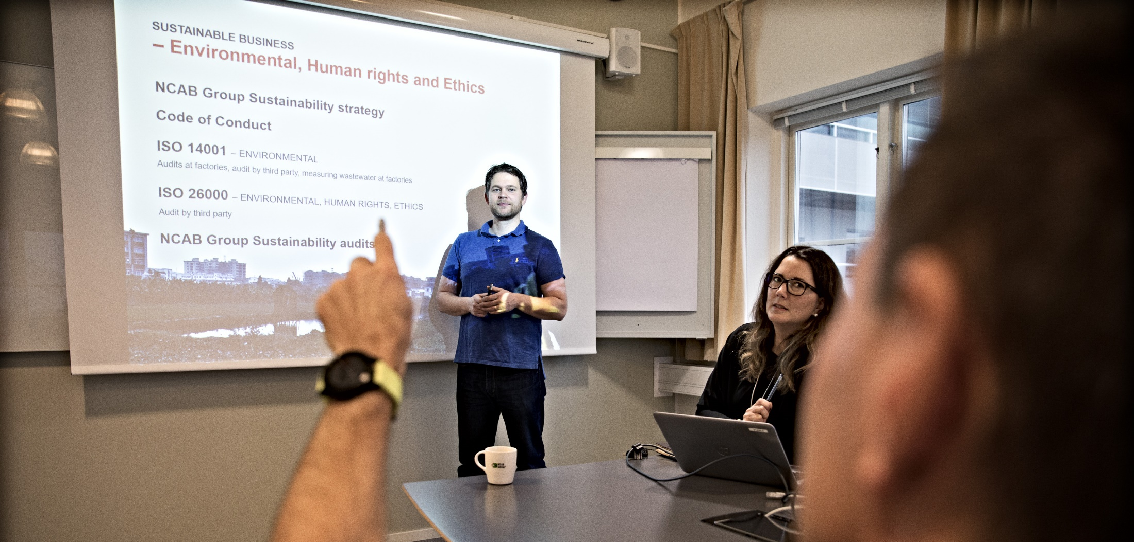
Create your ”Personal Performance Path” - Find your focus

Slide 2
Let’s create your Personal Performance Path!
This document will support you in finding your learning focus right from the start of your learning journey. What is important for you to learn, and why?
Instructions
Read through the Program Performance Path on page 3. It describes what you will learn in this program, how you can use it in your work, and the results which should follow.
Work through the questions on page 4. Reflect, discuss, and then document your Personal Performance Path in the boxes. Feel free to write in your preferred language.
Review this document together with your manager. Involving her/him will give you the support you need on your learning journey to create the best results.
You will review and adjust this document during the program, so don’t worry too much to get the "right answer" right now.

Slide 3
Program Performance Path
LEARNING OUTCOMES
The knowledge/skills the program intends to create
MOMENTS THAT MATTER
Scenarios where “Learning Outcomes” can be used to create a result (“Performance Outcomes”)
PERFORMANCE OUTCOMES
A result/achievement that an application of “Moments That Matters“ can give/create
BUSINESS RATIONALE
Why “Performance Outcomes” are important – the business/individual goals that “Performance Outcomes” contribute to
Understands the key elements and how to apply the Heed the Need-mindset throughout the sales process
Understand how to build strong customer relationships
Understands how different sales tools create professionalism and success, and how/when to use them (open questions, ABC, SPIN, ZOPA, BATNA, CHRIS, etc.)
Understand the importance of calling the customer
Ability to understand & argue for NCABs added values and USPs, and how NCAB differs from other suppliers
Ability to calculate healthy profits
Ability to identify high opportunity customers and projects (Conscious Quoting)
Ability to successfully follow up on high opportunity quotes, and agree on the next step
Understand how & why to use our systems efficiently in the sales process
Get clarity in daily processes and decisions, and the opportunities that exist
Ability to use one’s Learning Mindset
Understand the importance of and ability to give feedback to colleagues
Calls the customer throughout the sales process, using the sales tools to Heed the Need and helping the customer
Ensures long- and/or short term next steps in all customer contacts
Sets prices adapted to the customer, and calculates & ensures healthy profits on all quotes
Validates all RFQs
Performs quote analysis before quoting, ensuring a clear added value (Conscious Quoting)
Sets & follows an efficient quote follow-up routine, where high opportunity quotes are prioritized
Uses our systems to streamline processes and take strategic decisions
Actively negotiates with customer and factory
Leans in to the customer when complaints occur
Handles objections successfully and with confidence
Continuously feedbacks colleagues to support their growth, being a role model
Grows in security, confidence and boldness in the role
Increased number of “Strong Relationships”-customers
Higher win-rate on high opportunity customers
Higher Gross Margin and profit
Higher order line value
Higher Team Efficiency Index
Increased Customer Satisfaction Index & NPS
Increased number of part-numbers
Less quotes to low-opportunity customers
Less/stagnation of number of quotes
Less complaints / quality issues
Best Customer Service/Support in the industry
Top-engaged employees in our industry
Long-term growth
High, stable quality performance
High, stable delivery performance
Higher order intake
Higher revenue
Increased global Customer Satisfaction Index and NPS
High employee attraction rate among top talents in the industry

Slide 4
Personal Performance Path
YOUR PERFORMANCE OUTCOMES
Why is this program important to YOU? What do you want to achieve by participating in this program?
CONNECT WITH THE BUSINESS GOALS
How do your Performance Outcomes align with your business strategies, goals, or other priorities?
YOUR MOMENTS THAT MATTER
In which parts/situations in your role will it be extra important that you can use what you learned during this training, in order to achieve your desired Performance Outcomes?
YOUR LEARNING FOCUS
Which of the Learning Outcomes in the Program Performance Path will be extra important for you, to help you with your Moments that Matter?

Slide 5
Well done!
Now you should have a clearer picture of what you need and want to do to apply the learnings of this program, to achieve your results.

