Slide 1
Focus on Performance Crawl – Walk – Run
Not just learning, but doing
OCTOBER
NOVEMBER
DECEMBER
JANUARY
FEBRUARY
MARCH
APRIL
MAY
JUNE
JULY
27
10
24
15
19
9
2
23
13
4
25
14-15
6
1. Start – sales basics
2. USPs
3. Objection handling
4. 3 Ps + Time mgmt
5. Negotiation
6. How to pick the right factory
7. Validating RFQs & SPIN
8. Quoting & Gross Margin
9. Quote follow-up
10. Strategic business intelligence
11. Complaint handling
12. Workshop
13. Follow-up
Self-study & SMART-goals
Online Clinics
Offline workshop

Slide 2
Program Performance Path
LEARNING OUTCOMES
The knowledge/skills the program intends to create
MOMENTS THAT MATTER
Scenarios where “Learning Outcomes” can be used to create a result (“Performance Outcomes”)
PERFORMANCE OUTCOMES
A result/achievement that an application of “Moments That Matters“ can give/create
BUSINESS RATIONALE
Why “Performance Outcomes” are important – the business/individual goals that “Performance Outcomes” contribute to
Understands the key elements and how to apply the Heed the Need-mindset throughout the sales process
Understand how to build strong customer relationships
Understands how different sales tools create professionalism and success, and how/when to use them (open questions, ABC, SPIN, ZOPA, BATNA, CHRIS, etc.)
Understand the importance of calling the customer
Ability to understand & argue for NCABs added values and USPs, and how NCAB differs from other suppliers
Ability to calculate healthy profits
Ability to identify high opportunity customers and projects (Conscious Quoting)
Ability to successfully follow up on high opportunity quotes, and agree on the next step
Understand how & why to use our systems efficiently in the sales process
Get clarity in daily processes and decisions, and the opportunities that exist
Ability to use one’s Learning Mindset
Understand the importance of and ability to give feedback to colleagues
Calls the customer throughout the sales process, using the sales tools to Heed the Need and helping the customer
Ensures long- and/or short term next steps in all customer contacts
Sets prices adapted to the customer, and calculates & ensures healthy profits on all quotes
Validates all RFQs
Performs quote analysis before quoting, ensuring a clear added value (Conscious Quoting)
Sets & follows an efficient quote follow-up routine, where high opportunity quotes are prioritized
Uses our systems to streamline processes and take strategic decisions
Actively negotiates with customer and factory
Leans in to the customer when complaints occur
Handles objections successfully and with confidence
Continuously feedbacks colleagues to support their growth, being a role model
Grows in security, confidence and boldness in the role
Increased number of “Strong Relationships”-customers
Higher win-rate on high opportunity customers
Higher Gross Margin and profit
Higher order line value
Higher Team Efficiency Index
Increased Customer Satisfaction Index & NPS
Increased number of part-numbers
Less quotes to low-opportunity customers
Less/stagnation of number of quotes
Less complaints / quality issues
Best Customer Service/Support in the industry
Top-engaged employees in our industry
Long-term growth
High, stable quality performance
High, stable delivery performance
Higher order intake
Higher revenue
Increased global Customer Satisfaction Index and NPS
High employee attraction rate among top talents in the industry

Slide 3
Program Performance Path
LEARNING OUTCOMES
The knowledge/skills the program intends to create
MOMENTS THAT MATTER
Scenarios where “Learning Outcomes” can be used to create a result (“Performance Outcomes”)
PERFORMANCE OUTCOMES
A result/achievement that an application of “Moments That Matters“ can give/create
BUSINESS RATIONALE
Why “Performance Outcomes” are important – the business/individual goals that “Performance Outcomes” contribute to
Understands the key elements and how to apply the Heed the Need-mindset throughout the sales process
Understand how to build strong customer relationships
Understands how different sales tools create professionalism and success, and how/when to use them (open questions, ABC, SPIN, ZOPA, BATNA, CHRIS, etc.)
Understand the importance of calling the customer
Ability to understand & argue for NCABs added values and USPs, and how NCAB differs from other suppliers
Ability to calculate healthy profits
Ability to identify high opportunity customers and projects (Conscious Quoting)
Ability to successfully follow up on high opportunity quotes, and agree on the next step
Understand how & why to use our systems efficiently in the sales process
Get clarity in daily processes and decisions, and the opportunities that exist
Ability to use one’s Learning Mindset
Understand the importance of and ability to give feedback to colleagues
Calls the customer throughout the sales process, using the sales tools to Heed the Need and helping the customer
Ensures long- and/or short term next steps in all customer contacts
Sets prices adapted to the customer, and calculates & ensures healthy profits on all quotes
Validates all RFQs
Performs quote analysis before quoting, ensuring a clear added value (Conscious Quoting)
Sets & follows an efficient quote follow-up routine, where high opportunity quotes are prioritized
Uses our systems to streamline processes and take strategic decisions
Actively negotiates with customer and factory
Leans in to the customer when complaints occur
Handles objections successfully and with confidence
Continuously feedbacks colleagues to support their growth, being a role model
Grows in security, confidence and boldness in the role
Increased number of “Strong Relationships”-customers
Higher win-rate on high opportunity customers
Higher Gross Margin and profit
Higher order line value
Higher Team Efficiency Index
Increased Customer Satisfaction Index & NPS
Increased number of part-numbers
Less quotes to low-opportunity customers
Less/stagnation of number of quotes
Less complaints / quality issues
Best Customer Service/Support in the industry
Top-engaged employees in our industry
Long-term growth
High, stable quality performance
High, stable delivery performance
Higher order intake
Higher revenue
Increased global Customer Satisfaction Index and NPS
High employee attraction rate among top talents in the industry

Slide 4
Guidelines
Camera on during the whole time
Be active & present in the Breakout rooms
Sit by yourself (one computer per person)
Prepare to be present:
Don’t multitask
Close your Outlook/e-mail provider and other tabs
Put your phone on silent/do not disturb and screen down
Have your phones ready
Get a closed question? => Answer with only yes/no
Help each other grow – give feedback
Have a Learning Mindset
Give feedback to us!!!

Slide 5
Today’s agenda
Speed dating
Global sales strategy & HEED the NEED
Open & closed questions
ABC
SMART goal until next time

Slide 6
Speed Dating 1!
instruction
Briefly tell your:
Name
Where you work
Your favourite city in the world
Max 1 min per person!!!
5 people/room and 5 min in total!

Slide 7
Speed Dating 2!
instruction
Briefly tell your:
Name
Where you work
Your favourite food recipe
Max 1 min per person!!!
5 people/room and 5 min in total!

Slide 8
Inside Sales
Development Program

Slide 9
We chose our customers
We follow a plan
We own the Activities

Slide 10
Goal to 2025

Slide 11
1/3
High Mix Low Volume
21 000 000 000USD
World PCB production:
65 000 000 000 USD
Low Mix High Volume

Slide 12
HMLV
NCAB = 1%
Goal: + 1% by 2025

Slide 13
Strategy to 2025

Slide 14
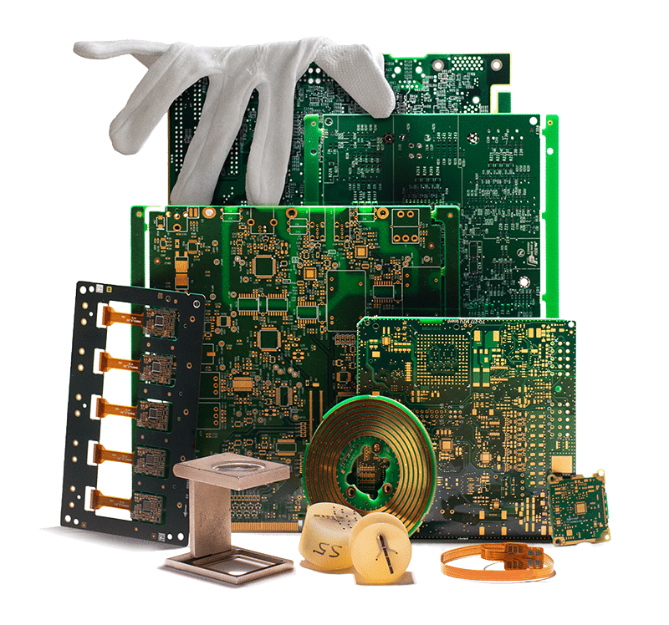
Our mission
PCBs for demanding customers, on time with zero defects, produced sustainably at the lowest total cost.

Slide 15
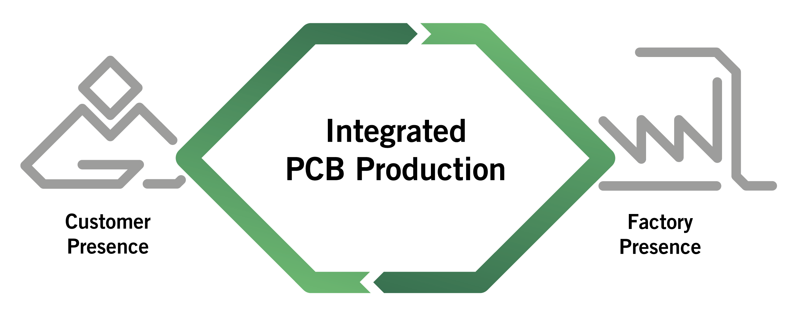
Full responsibility for the entire delivery
Notes:
Responsibility/Full responsibility for the entire delivery
Integrated PCB Production
Responsibility/Customer presence
Fast and easy communication
The local company is responsible for the entire deal with the customer.
The company is responsible for sales, purchasing, logistics, CAM engineering, complaints management, technical issues.
The companies all have CAM 350 and the group has two Genesis 2000 stations for checking Gerbers.
The customer has a partner in the local language.
One contact person
One contact person with complete responsibility, language, the same time zone, legislation, rapid response.
KAM, Key Account Management – the customer has many areas of contact at NCAB; sales, technology, logistics, Managing Director etc. The local Managing Director is responsible for his/her own Profit and Loss.
In-depth knowledge of each customer’s needs
High level of understanding for each customer, we get to know the customer well thanks to our organisation/language.
The customer is always central, as the local company is backed up by central support units, such as the development of new systems, marketing, development/follow up for our factories, future PCB technologies/new standards, general quality issues/quality follow up at a central level etc.
Factory presence
Presence gives control
An integrated producer “owns” the most important things; the relationship and the process with both customers and factory.
We have routines that are deeply embedded in our factories, as well as our own staff in the factories.
63 people in China who work on developing the factories.
30 technicians who work closely with our customers in order to optimise design and Gerbers.
50 people in customer support, design support, sales, quality assurance, etc.
We take responsibility for the entire PCB delivery.
We take responsibility if something goes wrong.
Our position gives you a competitive advantage
Security through reduced risk
Reduced TTM
Faster deliveries
Long term thinking
The right design
---
Global player/business risk
We take responsibility and reduce your business risk
You do business only with NCAB
Security and reduced risk for you; complaints, cash-flow, payment terms – we take the financial risk. We never pass the blame, it is always the NCAB Group that you do business with, no one else.
Always direct contact with the NCAB Group’s local companies. One negotiating partner; it is the NCAB Group that the customer does business with, not 10 different factories.
We take full responsibility for the entire delivery
We take full responsibility for the entire delivery (e g. that the Gerber files are complete before they are sent, we select and purchase from the right factory with financial stability etc.)
NCAB has its own dedicated factories where we own large parts of the processes.
We have our own staff who work in some of our factories, e g. working with quality, doing mini-audits etc.
We take full responsibility for complaints, which are dealt with rapidly. If necessary, we supply new PCBs/rapid deliveries at no extra cost.
We replace components if the PCB is mounted, NCAB is responsible for solving the problem financially and compensates a maximum of 2 x PCB price (see general conditions).
For contract customers, the agreed levels apply.
The parent company acts as a financial guarantor to all the companies, so that even the smaller ones can take on a major level of responsibility.
We have exclusive agreements with our main factories.

Slide 16
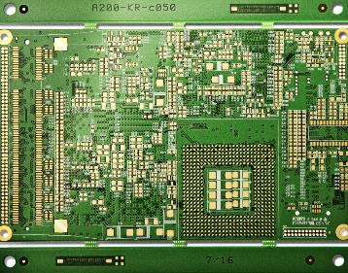
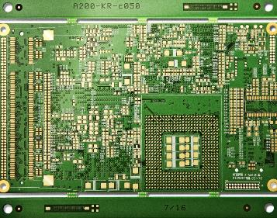
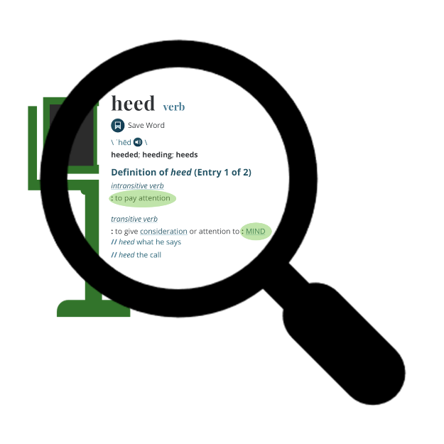
Notes:
we also pick our customers carefully. *fit our business
When we find our kind of customer, we can put a lot of effort into *serving them, and believe that the potential business will be worth it.

Slide 17
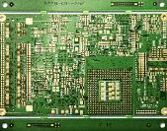
Notes:
So, our way is heed-the-need. Find *the right customers and *learn everything about their needs.

Slide 18
We choose our customers!
We choose our projects!

Slide 19
OUR CUSTOMERS
60% EMS
40% OEM

Slide 20
2600 customers
$230M order income

Slide 21
2600 customers
$230M order income
90% of our total order income
230 customers

Slide 22
We are a people business
You are the difference

Slide 23
What question/s do you have right now?

Slide 24
Who’s there?
exercise
Michael is a famous person.
Ask him questions to find out who he is. He will only answer questions where he can answer yes/no.
First person to guess who it is wins!
How many questions will you need?
You have 2,5 min!

Slide 25
Who’s there? – PART 2
exercise
Michael is now a new famous person.
Ask him any questions to find out who he is.
First person to guess who it is wins!
How many questions will you need?
You have 2,5 min!

Slide 26
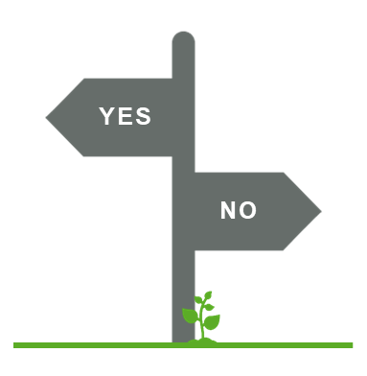
Open / Closed questions Easy to understand – harder to re-wire
CLOSED
What is a closed question? What are they good for?
OPEN
What is an open question? What are they good for?

Slide 27
= What’s on my mind
= What’s on their mind

Slide 28
Breakout room: Turn closed questions to open
instruction
You will soon see some commonly used closed questions.
Turn them into open questions together in your breakout rooms.
Give feedback & dare to discuss if you don’t agree!
You have 7 min.
Are you happy?
How are you?
Have you thought about this?
What are your thoughts about this?

Slide 29
Turn these closed questions to open questions together! (7 min)
Can I call you back tomorrow?
Is your poject going well?
Do you have a moment to speak to me?
Is sustainability important to you?
Are you stressed?
Do you think it’s too expensive?
Is Suntak a PCB supplier to you?
Do you have any other projects at the moment that I can help you with?
Is your process moving along as planned?
Did you like our quote?
Did my offer meet your expectations?
Are you happy?
Do you have any questions?
Will you call me back?
Do you agree?
Is there something wrong?
Did you have a nice weekend?
Did their offer include freight?
Can I do something to help you?
Do you know when you will decide?
Any feedback for me?
OPEN QUESTION CHECKLIST
Who
What
When
Why
How
Where

Slide 30
Break!
Please open My Profile in Sympa > ”Learning & Development” > ”Goals & Coaching”

Slide 31
Breakout room: Respond with an open question
instruction
Now we will practice to use open questions in response to a customer question/statement.
Take turns on who acts as customer and who responds
Give feedback to each other, and dare to discuss if you disagree!
Start in alphabetical order, then rotate
You have 20 min
CUSTOMER
Do you produce PCBs?
A
Totally! About XX million every year! How is your PCB situation?
B
C
How many are you in your FM team?

Slide 32
Respond to these questions/statements with an open question! (20 min)
I need my quotes faster?
Factory Management team, sound expensive!
We never get any information from you.
We need a sustainable PCB producer.
All traders claim to deliver on time, but no one ever do.
When can i have my quotes back?
Your prices are higher than other suppliers.
Do you own factories?
We need help with warehousing.
Do you have high quality levels?
Is your delivery perfomance good?
We are concerned about conflict minerals.
Maybe we should just buy direct?
We already have a great trader.
Can I have my order delivered 1 week earlier?
We will not accept short shipments.
You traders never deliver the quality that you promise...
Your quality is excellent!
Your order acknowledgement is allways late?
Can you respond to EQs within 24 hours?
Can you deliver by train?
I think you are too big for us.
I’ll let you know what we decide.
Do you have tech support?
Are you fast on delivering prototypes?
Do you have people in the factories?
Do you host any seminars/webinars?
You are a great supplier!
Who, What, When, Why, How, Where

Slide 33
Example
What are the differences between the two calls?
Listen for:
Open/closed questions?
ABC?

Slide 34
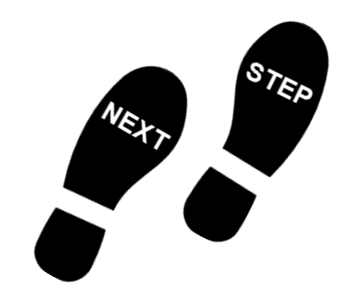
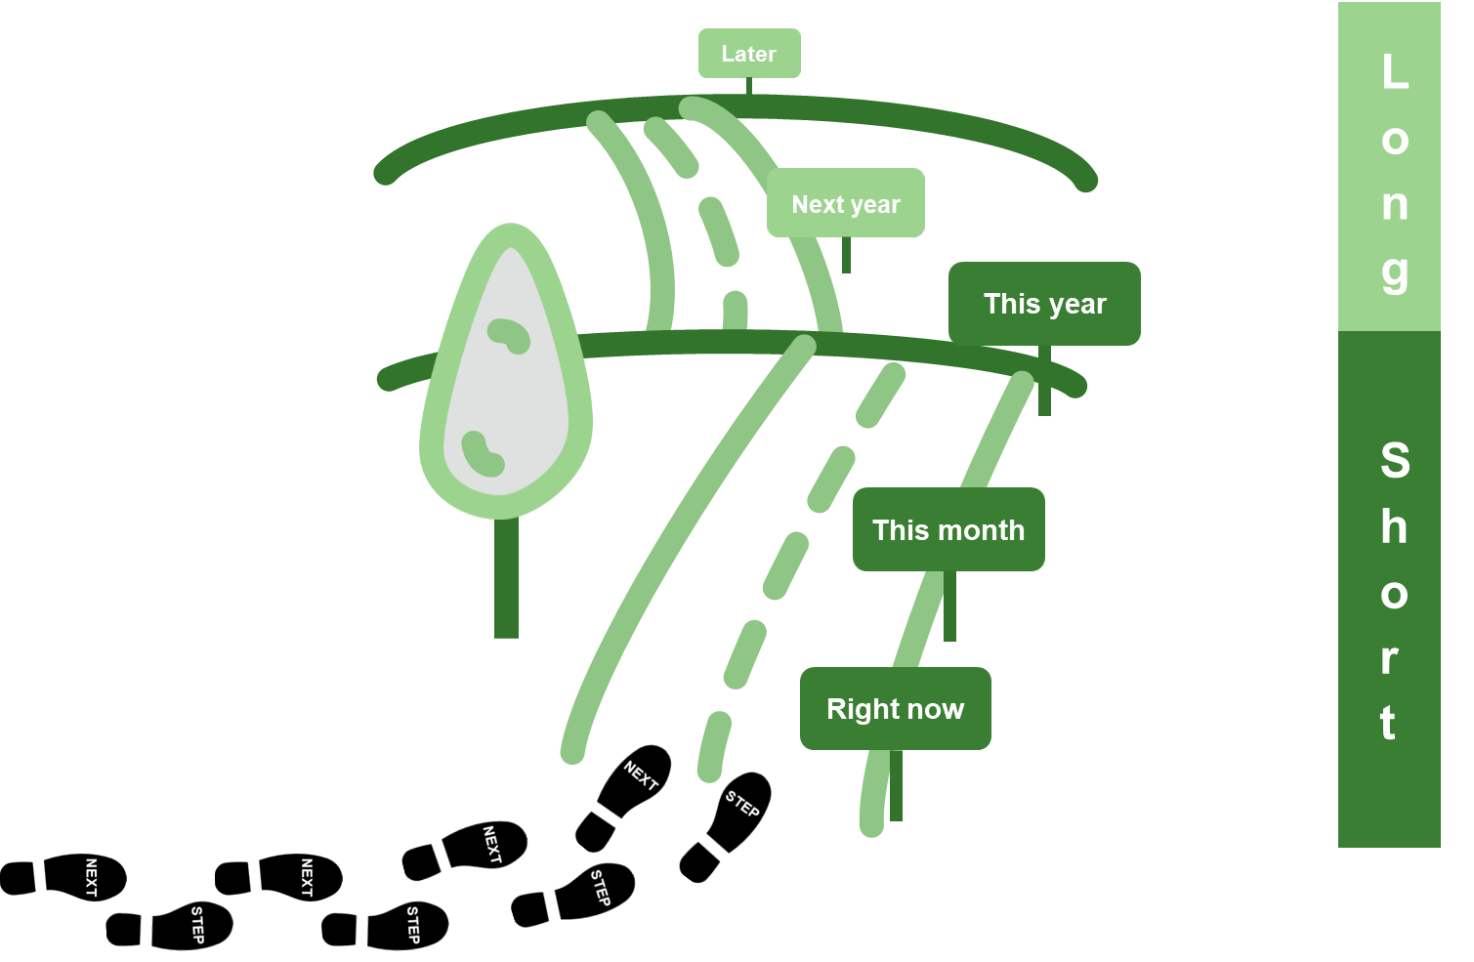
What does ABC mean in NCAB?
ABC
Notes:
If the customer says “I will call you when I know more”, that’s not ABC. The ABC should always be in our hands, meaning that we are doing the next activity. Closing means that we should have the customer’s agreement to call back, and having that agreement makes it so much easier to start the next conversation.
Asking for agreement shows the customer that we take Full Responsibility, and that we want to build Strong Relationships. We live our values.

Slide 35
Breakout room: Agree on a next step
instruction
You will soon see some common customer statements.
How can you use ABC and agree on a next step (in your hands) on the situations?
Take turns on who acts as customer and who responds. Start in alphabetical order.
You have ~12 min.
CUSTOMER
I’m very busy!
A
Sure, when can I call you back?
B
C
I can’t talk right now!
I understand, when would it be appropriate for me to call you back?

Slide 36
Use ABC and agree on a next step (in your hands) on the following situations: (12 min)
”I have received your quote, but we haven’t made any decision yet.”
”We don’t have any other projects going on right now.”
”My manager wants to talk to you.”
”I need to learn more about conflict materials to take a decision.”
”Your samples came in yesterday.”
”We will need DFM on these parts.”
”I will call you when I know more.”
”We would like to know more about IPC class III.”
“We would like to know more about the delivery situation.”
OPEN QUESTION CHECKLIST
Who
What
When
Why
How
Where

Slide 37
My SMART-goal until next time – How will you practice IRL? Crawl – Walk – Run
S
M
A
R
T
PECIFIC
“I will use ONLY open questions in my next 5 conversations.”
“I will get better at using open questions.”
“I will get better at using open questions.”
EASURABLE
CCEPTED
“I will start closing more often.”
“I will use ABC in all my customer calls until the next clinic on November XX.“
“I will start closing more often.”
ELEVANT
IME-BOUND

Slide 38
My SMART-goal until next time – How will you practice IRL? Crawl – Walk – Run
S
M
A
R
T
PECIFIC
Think about your SMART-goal that you will do until next time.
Write it down in in your Sympa-profile > ”Learning Development” > ”Goals & Coaching”-tab.
We will follow up how it went at the next Clinic.
EASURABLE
CCEPTED
ELEVANT
IME-BOUND

Slide 39
Next clinic: Our USPs with Rikard Wallin
In NCAB Academy:
Your feedback about the Clinic
Set your Personal Performance Path together with your manager
Complete NCAB Academy-course ”Our USPs”
Complete your SMART-goal

