Slide 1
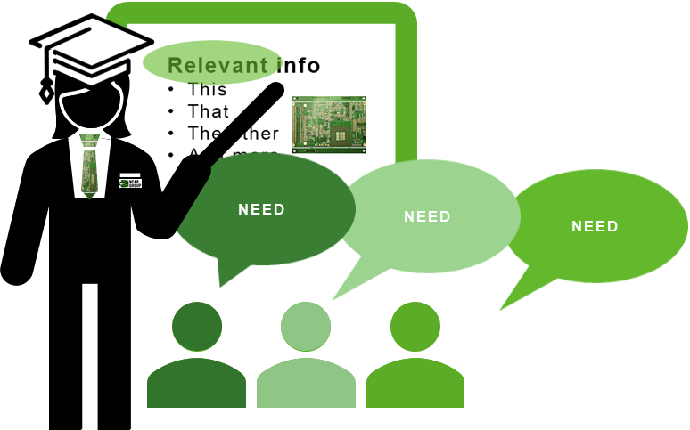
Roleplay: Presentation
5 ps
Now we will practice to present according to the 5 Ps! You need to be at least 2 people in this exercise. Take turns on who is a customer and who is an NCAB salesperson.
Pick and agree on a real customer together. It can be a customer you have already met, or will meet soon.
SALESPERSON
2. Prepare a presentation of NCAB to the customer that you can be passionate about.
Plan the presentation based on what you think they want to know. What do you want them to remember one week later?
Use something that is not a PowerPoint, or complement your PowerPoint with some other relevant material.
Keep your presentation to under 5 minutes.
How can you do this presentation so that it encourages the customer to talk? Prepare some open questions to ask so that you can comfortably listen as much as possible.
3. Present the presentation you have prepared to the customer.
CUSTOMER
2. Research on what you think the customer (you) would like to know. Write down some questions for NCAB for the presentation.
3. Act as if you were the customer during the presentation.
4. Feedback session!
3 things that were good? Passion – Personality (smile & ask questions) – Preparation – Presentation – Professionalism
1 thing that could be improved? Passion – Personality (smile & ask questions) – Preparation – Presentation – Professionalism
Was it one-way or two-way communication?

